Slide 1
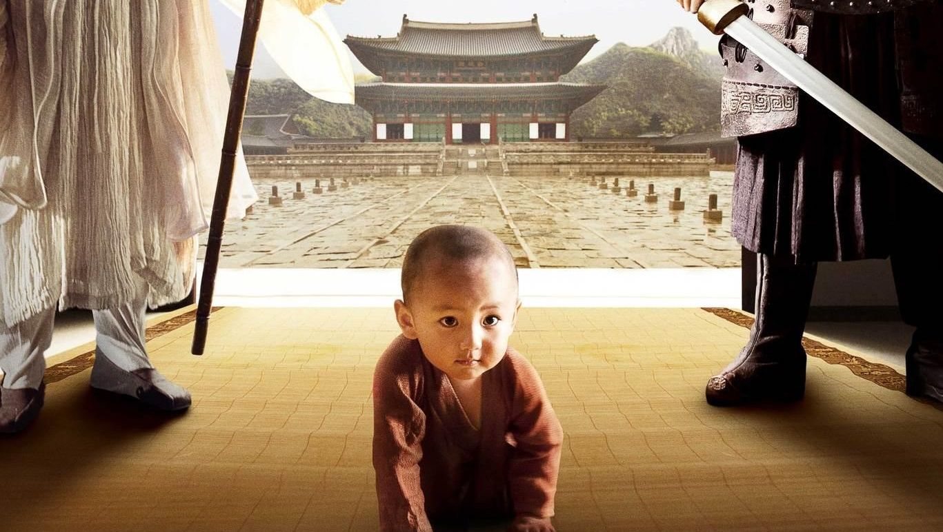
WORLD HISTORY
with Mr. Jim Soto
The Zhou Dynasty & New Ideas

Slide 2
Think...
You are a student of the famous teacher Confucius. Like many older Chinese, he thinks that society has changed- and not for the best! He believes in old values and a strict social order. He is trying to teach you and your fellow students how to behave as gentlemen. You must respect those who are superiors in society. You must set a good example for others. How will these teachings affect your life?
Take a minute to write your answer down.

Slide 3
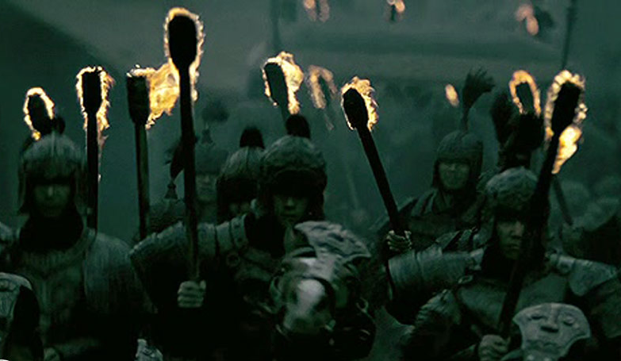
The people of the Shang dynasty made many advances, including beautiful metalwork, a writing system and a calendar. The next dynasty, the Zhou, established other Chinese traditions. Some of these traditions included the importance of family and social order. Later thinkers looked back with admiration to the values of the Zhou period.

Slide 4
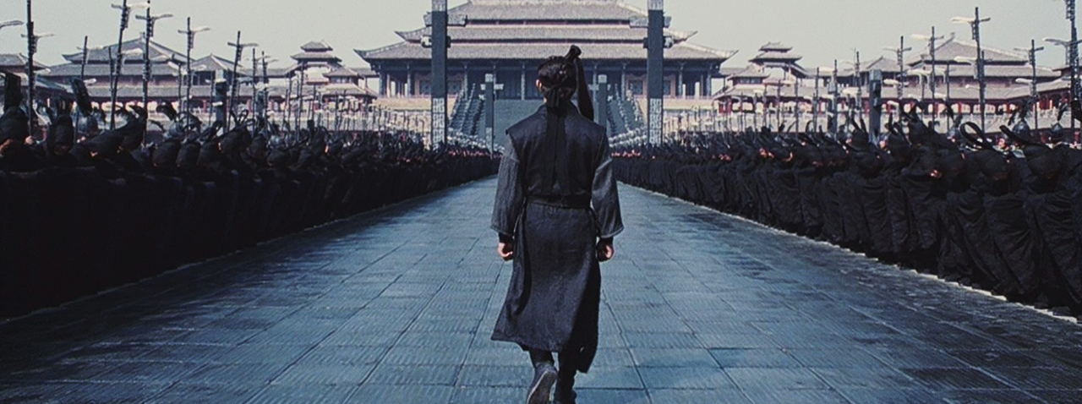
To learn more about this topic read pages 166 thru 171 and complete the section 2 assessment. Show me the completed work when complete.

Slide 5
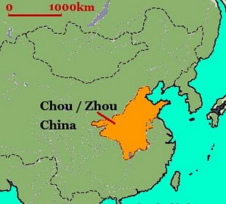
The Zhou Dynasty
he Zhou Dynasty followed the Shang Dynasty, ruling from 1046 BC to 256 BC making it the longest ruling Chinese dynasty in history. The Zhou Dynasty is usually divided into the Western Zhou, which ruled from 1046 B.C. to 771 BC, and the Eastern Zhou, which ruled from 770 BC to 256 BC.

Slide 6
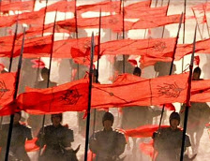
Zhou Political System
1046 BC, the Shang Dynasty was overthrown at the Battle of Muye, and the Zhou Dynasty was established. The Zhou created the Mandate of Heaven: the idea that there could be only one legitimate ruler of China at a time, and that this ruler had the blessing of the gods. They used this Mandate to justify their overthrow of the Shang, and their subsequent rule.
Click Here!

Slide 7
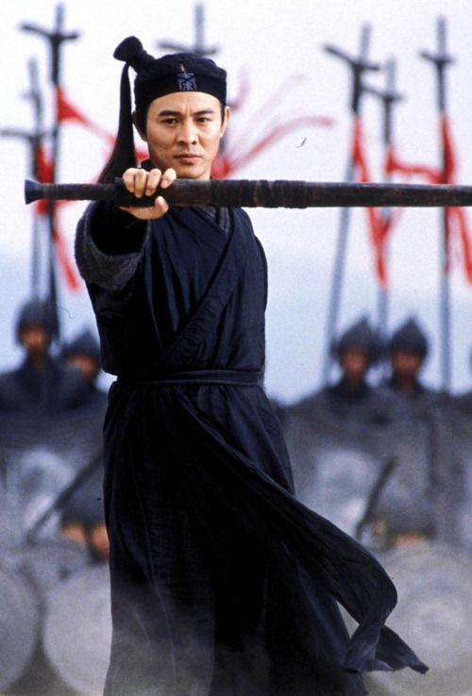
The Zhou period as a whole was a time of dramatic change for ancient China, in government, war, philosophy, economy and society.
In their new political order, they granted land to others in return for their loyalty, military support, and other services. The king, being at the highest level granted plots of land to lords, or people high rank. Lords paid taxes and provide soldiers to the king as needed.

Slide 8
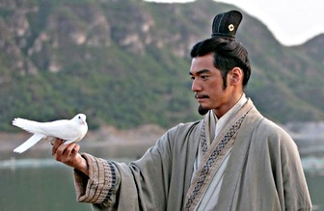
Peasants, or farmers with small farms, were at the bottom of the order. Each peasant family received a small plot of land and had to farm additional land for the noble.
Ruling through the lords, helped the Zhou control distant locations and ensured loyalty to the king and stability to the kingdom. Eventually, this order broke down because after each succession lords were less loyal and gained more power.

Slide 9
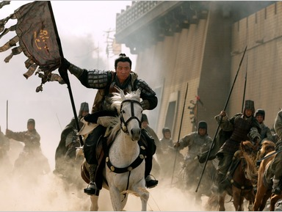
Zhou Decline
At the end of the Zhou dynasty it became unstable with constant wars with raiders from the north. Its capitol moved east to avoid more raiding. The government had become corrupt with help of a king who only cared about himself, the cruel King Zhou Li Wang. Nobles became powerful as the king's power declined. Eventually, the unity of the Zhou dynasty split off into the Warring States period where powerful lords fought for the domination of China.
Click Here!

Slide 10
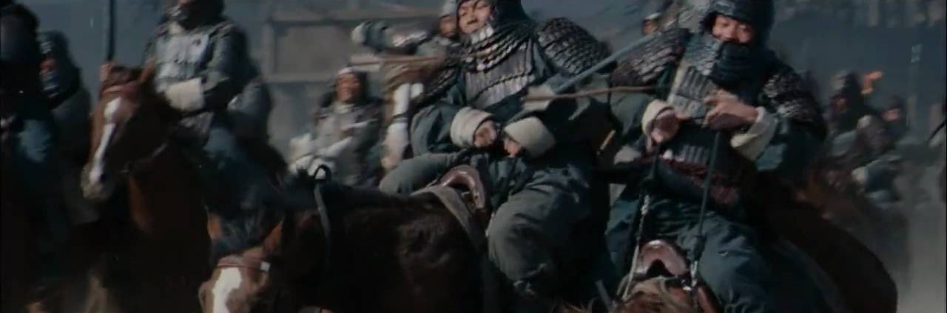
The Warring States period saw a great deterioration of the family. It was not uncommon to see loyalties between brothers and brothers, and children and parents weaken in a frenzy to grab wealth and power. China fell into great chaos.

Slide 11
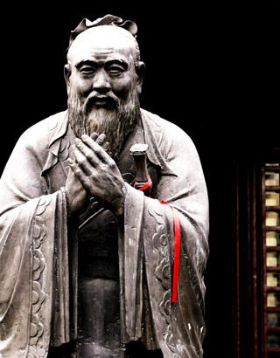
Confucius & Society
During the late Zhou period, thinkers came up with ideas on how to restore order to the country. The most famous of them was Confucius (551 BC to 479 BC), also known as Kong Qui or K'ung Fu-tzu, was a Chinese philosopher, teacher and political figure. His teachings, preserved in the Analects, focused on creating ethical models of family and public interaction and setting educational standards.

Slide 12
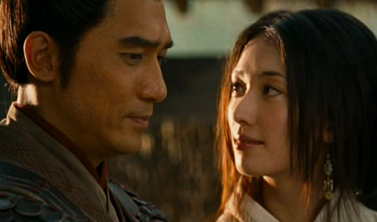
The teachings of Confucius became known as Confucianism. These teachings have played an important role in forming Chinese character, behavior and way of living. Because of people’s lack of decency, he said the Chinese needed ethics, or moral values. Its primary purpose is to achieve harmony, the most important social value.

Slide 13
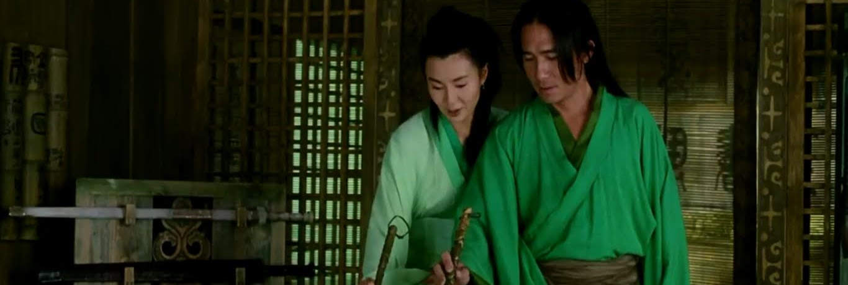
To Confucius, the main objective was to teach people to live with integrity. Through his teachings, he strove to resurrect the traditional values of benevolence, propriety and ritual in Chinese society and the importance of family loyalty, which was severely damaged during the Warring States period.

Slide 14
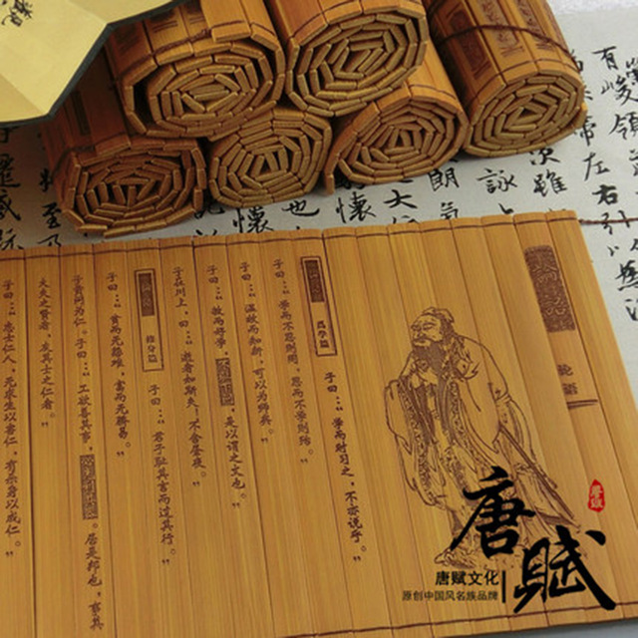
The Analects are a collection of the teachings and thoughts of Confucius. They have greatly influenced the moral and philosophical values of China. They contain The Five Constant Relationships which outline how one should act in society, being the relationships between parent and child, husband and wife, elder sibling and junior sibling, elder friend and junior friend, and ruler and subject.
Click Here!

Slide 15
Daoism & Legalism
In addition to Confucianism, two other belief systems emerged during the Zhou period that attracted many followers: Daoism and Legalism.
Daoism, or Taoism, arose about the same time as Confucianism. Lǎozǐ is considered to have written a book of 81 chapters, named Tao Te Ching, a classical Chinese text, mainly concerning dào or "way". It stresses living in harmony with the Dao (or Tao), which is the guiding force of all reality.

Slide 16
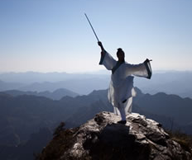
Daoism developed as a reaction against Confucianism because they didn’t believe that active involved leaders could bring social harmony.
They believed that people should not interfere with nature or other people and, like water, let things flow in a natural way.
Daoists admired nature so much, they worshipped it , which contrasted with Confucianism’s focus on the human arena.

Slide 17
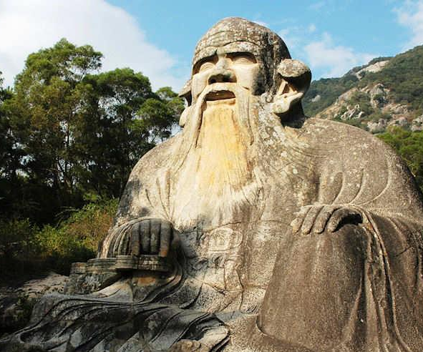
Lǎozǐ, the most famous Daoist philosopher, taught that Dao is the law of nature. It is not only just laws of nature, it is the true laws of nature. He believed that rulers should take little control and do only what would help people achieve their natural desires.
He was later worshipped as a god. Belief in the revelation of the Dao from the divine Lǎozǐ resulted in the formation of the Way of the Celestial Masters, the first organized religious Taoist sect.

Slide 18
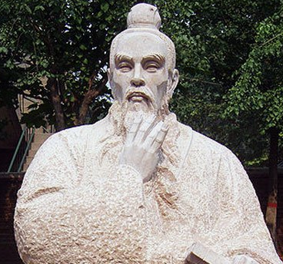
Legalism, a school of Chinese philosophy that attained prominence during the turbulent Warring States era and, through the influence of the philosophers Shang Yang, Li Si, and Hanfeizi, proposed that people were so morally corrupted that a strong government was needed to control them and maintain social order.
Legalists disagreed with the morality of Confucianism and what they saw as Daoism’s lack of respect toward authority.

Slide 19
Final thoughts
When the Zhou dynasty crumbled, political and social chaos erupted.
As a response, the new teachings of Confucianism, Daoism & Legalism emerged.

Slide 20
NEXT
Qin
Jim Soto © 2018

