Slide 1
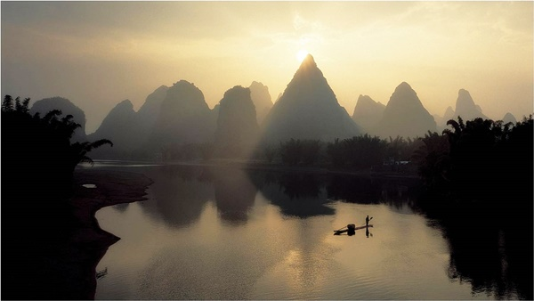
WORLD HISTORY
Geography & Early China
with Mr. Jim Soto

Slide 2
Think...
You live along a broad river in China in about 1400 BC. Your grandfather is a farmer, He tells you wonderful stories about an ancient king. Long ago, this legendary hero tamed the river’s raging floods. He even created new rivers. Without him, no one could farm or live in this rich land. Why is this legend important to your family?
Take a minute to write down your answer.

Slide 3
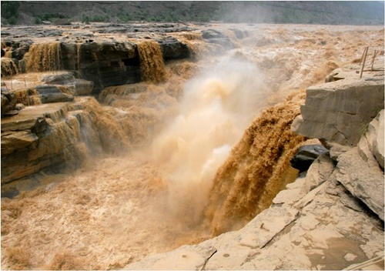
Like other river civilizations, the Chinese people had to learn to control floods and irrigate their fields. China’s geographical features divided the country into distinct regions

Slide 4
To learn more about this topic read pages 160 thru 165 and complete the section 1 assessment. Show me the completed work when complete.

Slide 5
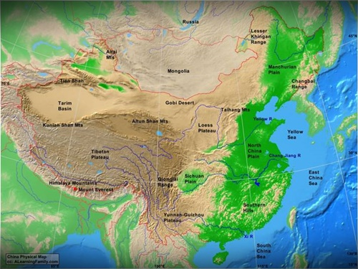
A Vast and Varied Land
China makes up roughly 4 million sq. miles of very varied landscapes.
It comprises about 6.5 per cent of the world total land area.
Modern China is the third largest country in the world, just behind Russia and Canada. Two-thirds of its total land area covered by mountains, hills and plateaus.

Slide 6
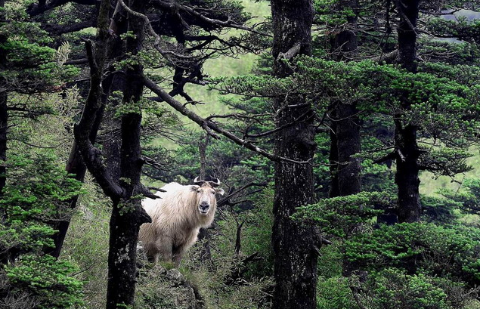
The Gobi desert in northern China separates the country from its neighbors.
Eastern China has low-lying plains which form one of the largest farming regions.
The Pacific Ocean makes up the eastern border.
Rugged mountains make up western China. Qinling Shandi, an important mountain range, separates N. China from S. China.
The tropical south east is the wettest region.
Click Here!

Slide 7
The Rivers of China
Rivers also play a major role in China, both for transportation and for irrigation. Two major rivers flow west to east.

Slide 8
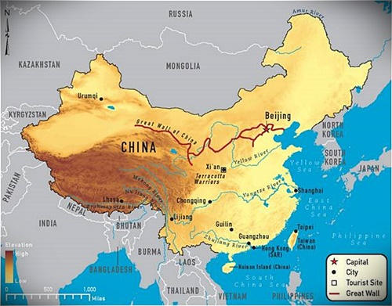
Huang He or Yellow River
Stretches 3000 mi across N. China
River often floods and leaves layers of silt
Nicknamed “China’s Sorrow” because these floods can be very destructive
Chang Jiang or Yangzi River
Cuts through central China
Third longest river in the world
River often floods and leaves layers of silt
Nicknamed “China’s Sorrow” because these floods can be very destructive

Slide 9
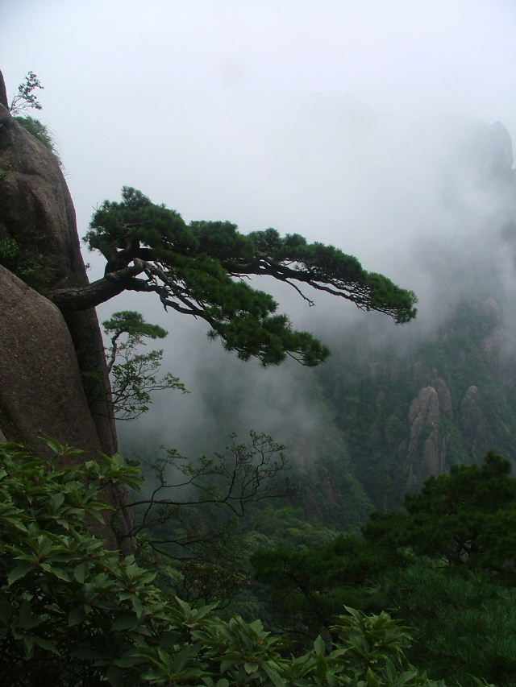
Civilization Begins
Early Settlement and Isolation Archaeologists have found remains of what may be the first inhabitants of China. These hunter-gatherers lived in caves more than 500,000 years ago. Later, farmers established the first permanent settlements on the North China Plain, near the Huang He, or Yellow River..

Slide 10
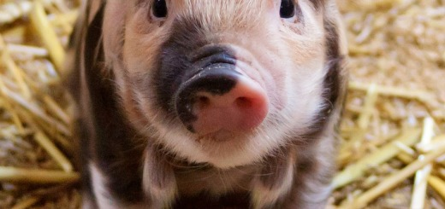
Ancient Chinese began farming rice in the middle of the Chang Jiang Valley, over 9,000 years ago. Farming made life easier because people no longer had to travel to hunt animals, but could grow their food where they lived. Rice, wheat and millet were the three main crops grown in Ancient China.
Animals such as: pigs and sheep were domesticated.

Slide 11
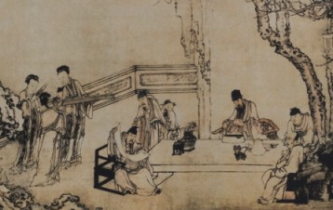
An urban civilization did not emerge in China until about 2000 BC, about a thousand years later than in Mesopotamia, but it emerged as a large and highly developed kingdom. The first three dynasties to rule China were the Xia (or Hsia) dynasty, the Shang dynasty, and the Zhou (or Chou) dynasty.

Slide 12
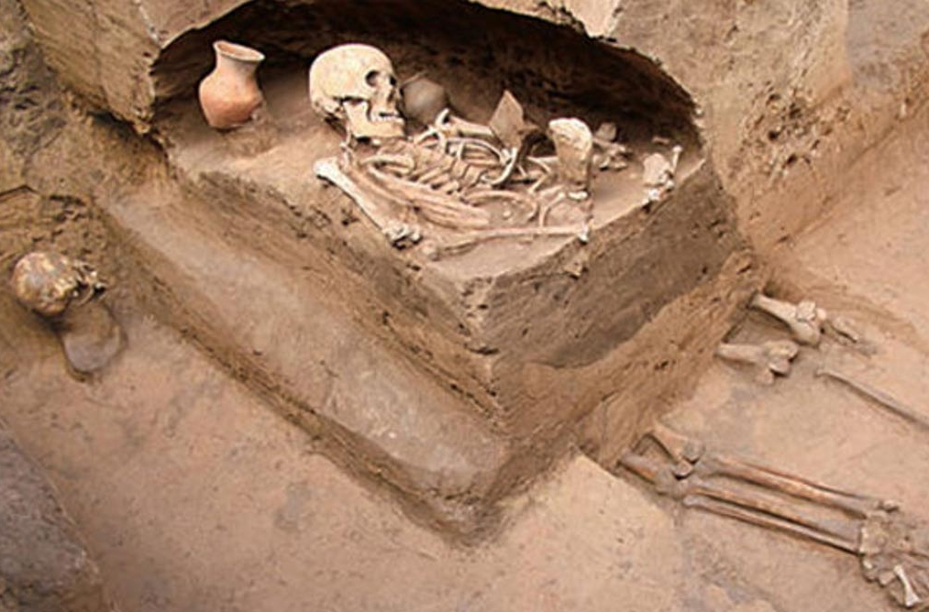
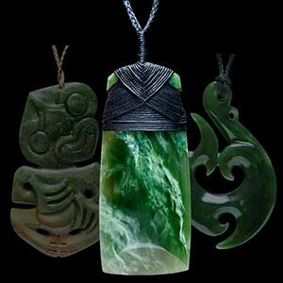
As populations grew, Chinese developed pottery, tools, weapons and religious beliefs that included the concept of an afterlife. Many graves contained artifacts and jewelry made from jade, a hard green gemstone.
Click Here!

Slide 13
China’s First Dynasties
Throughout most of China's history it was ruled by powerful families called dynasties. The first dynasty was the Xia and the last was the Qing. Ancient China also boasts the longest lasting empire in history. It began with the Qin dynasty and the first emperor Qin who united China under one rule in 221 BC.

Slide 14
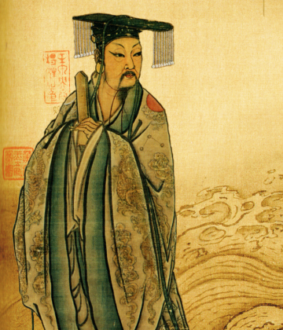
The Xia Dynasty (c. 2070-1600 BCE) was the first government to emerge in ancient China and became the first to adhere to the policy of dynastic succession; thus making it the first dynasty of China. It is said to have been founded by Yu the Great. Legend says that he dug the major waterways of north China to channel away the terrible floodings that occurred during his lifetime.
Click Here!

Slide 15
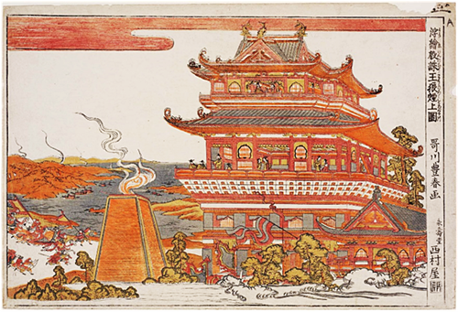
The Shang Dynasty was a period that began in Yellow River valley around 1600 BC and lasted to 1046 BC. The Shang Dynasty is known for its technological advancement and sophisticated craftsmanship in bronze and ceramic. They strengthened their rule by continuing irrigation and flood control systems.
They used war chariots and bronze weapons to defend kingdom’s borders.
Economy was based on agriculture.

Slide 16
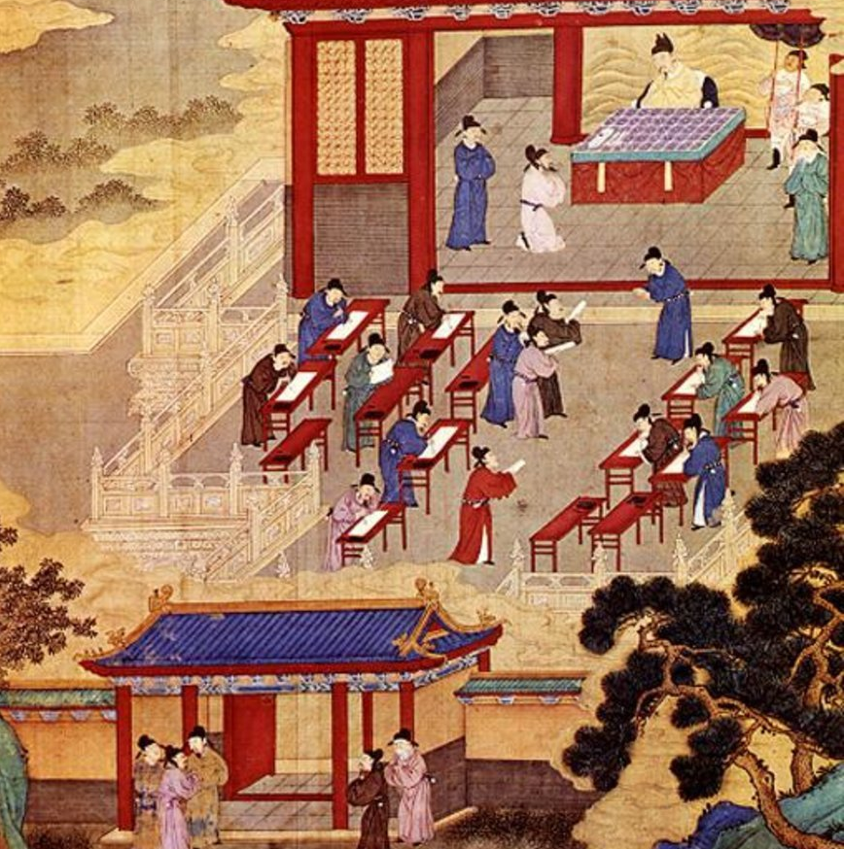
The Zhou Dynasty (1046-256 BC) was the longest-lasting of ancient China's dynasties. It followed the Shang Dynasty (c. 1600-1046 BC) and it finished when the army of the state of Qin captured the city of Chengzhou in 256 BC.
It had no centralized government. They believed in “Mandate of Heaven” or that God chose rulers.
Local leaders fought amongst themselves most of the time. Eventually one of the Warring States, the Qin, took over as rulers.

Slide 17
Chinese Writing
Whatever the obscure initial phase of written Chinese was, its appearance during the Shang dynasty already exhibited sign of a very complex system, which had more than 2,000 symbols to express words or ideas. The earliest form of Chinese writing is called the oracle bone script, used from 1500 to 1000 BC.

Slide 18
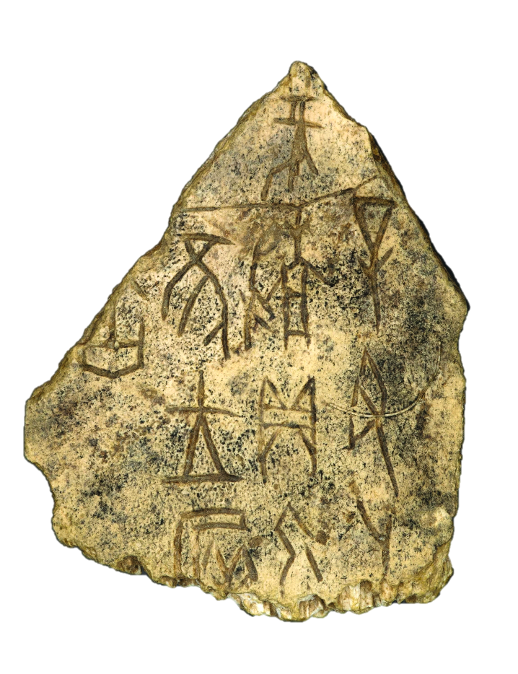
Shang writing has been found in thousands of cattle bones and turtle shells. Priests carved questions about the future on them, which were then heated, causing them to crack. Priests “read” these cracks believing that they revealed the future. The bones were called oracle bones because an oracle is a prediction of divine origin.
Click Here!

Slide 19
Final thoughts
China is a vast land with a diverse geography.
Ancient Chinese civilization developed in the fertile valleys of the Huang He and the Chang Jiang.
Civilization there advanced under Shang rule.
People developed a social order, a writing system, and made other achievement.

Slide 20
NEXT
ZHOU
Jim Soto © 2018

