Slide 1
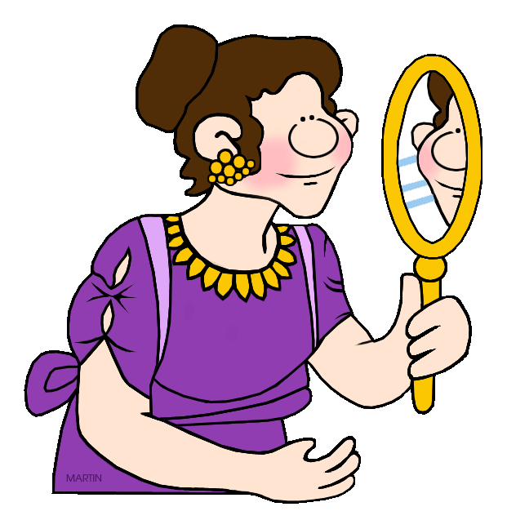
Q2
Response to Literature
Jim Soto

Slide 2
Lesson Objective
Understanding what a response essay is
Understanding the content and form of response essays
Planning, drafting, revising, editing, and publishing a response essay
Pages 287-316

Slide 3
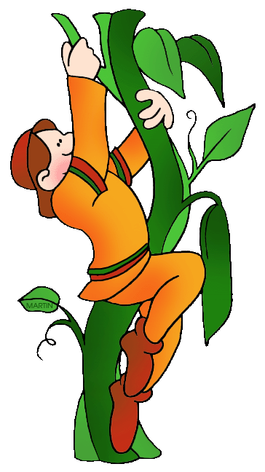
Retell. Interpret. Show.
A response essay is a short piece of writing in which you:
Retell key events in a story
Interpret the theme of s story
Show how the development of the main character relates to the development of the theme

Slide 4
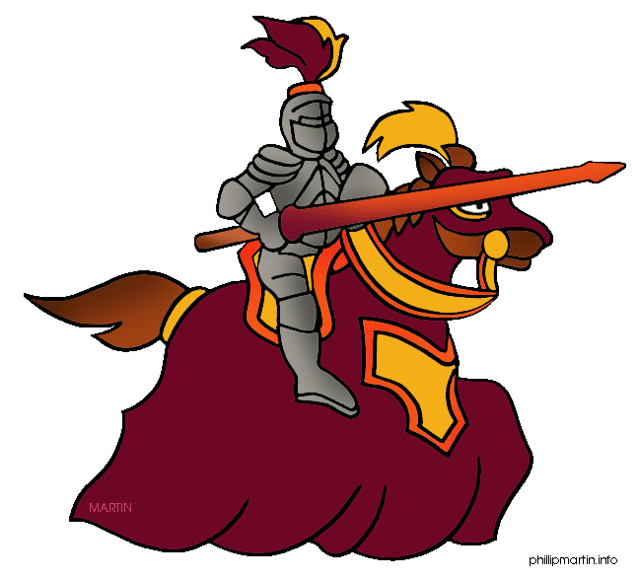
The Response Essay
Don’t be intimidated by the word “interpreting”. The word just means examining important events in a story and understanding how they reveal a message about life or human nature.

Slide 5
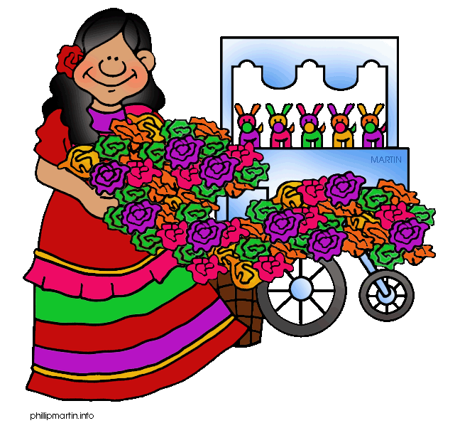
The Response Essay
To better understand response essays read the sample, Esperanza Rising, in pages 289-290 and complete the Respond to the Reading activity. A discussion will ensue in 15 minutes.

Slide 6
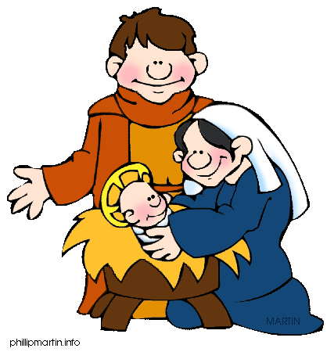
Patterns of Organization
To better organize your response essay remember that they could include:
Chronological Order - or the order in which they happen over time
Order of Location - or in the spatial relations things have with one another
Logical Order - or the order in which they make more sense

Slide 7
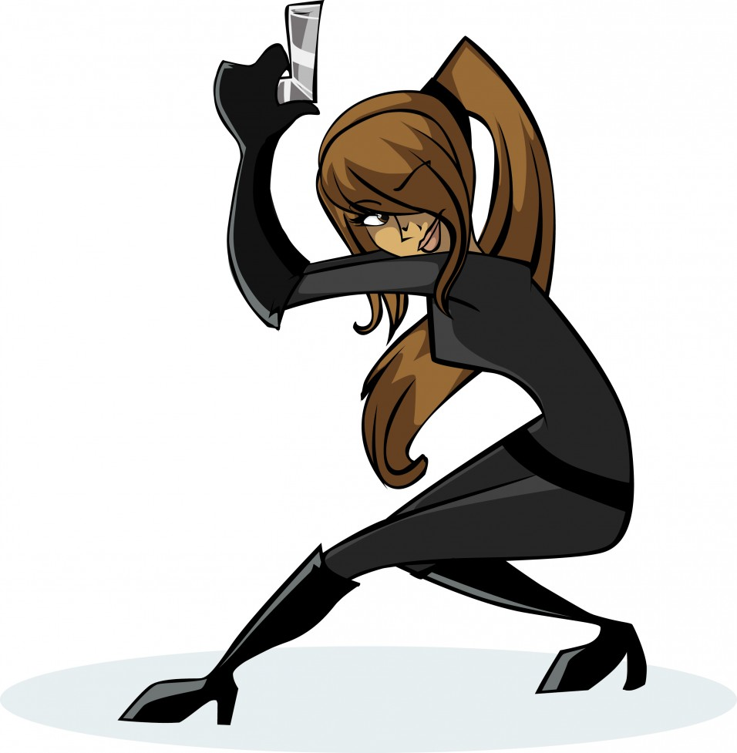
Responding to Literature
Your new “mission” will be the creation of an essay responding to a literary work of your choice. Bring in your book tomorrow to use as a reference for this task. Maybe the one you used for your book report will do!

Slide 8
About stories...
To better understand and interpret a story, keep the following principle in mind: EVERY story, ever told is about SOMEONE, that WANTED something, BUT someone or something got in the way to OPPOSE this, SO this SOMEONE had to struggle to GET it.

Slide 9
About stories...
In other words, look at a story as the account of a PROBLEM that had to be solved or overcome.
If you approach stories in this manner, you’ll be capable of better interpreting any narrative!

Slide 10
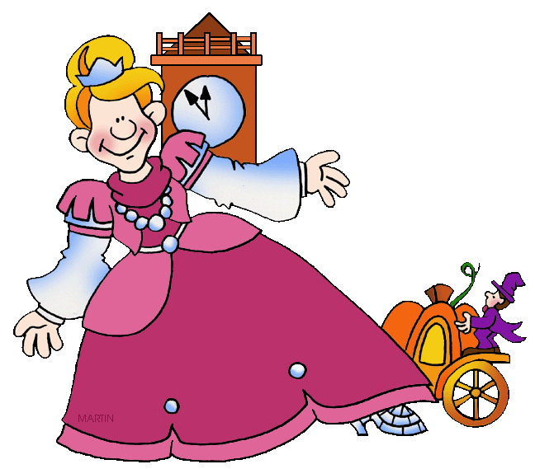
Time to Get Our Feet Wet...
You will work in your response to literature by gathering with your team leader and working with your peers for the next four days. Help each other out. Read and complete the activities at the bottom of pages 291-316.

Slide 11
Homework
In your Skills Book complete pgs. 97-102.
Sentence Problems Review 1
Sentence Problems Review 2
Rambling Sentences
Wordiness
Double Negatives & Incorrect Usage
Merry!

Slide 12
Next
Test #2
Jim Soto © 2015

