Slide 1
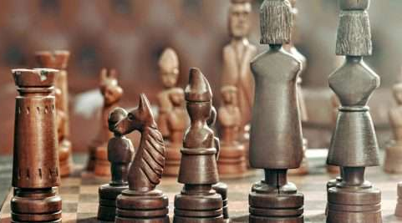
WORLD HISTORY
with Mr. Jim Soto
Indian Achievements

Slide 2
Think...
You are a traveler in western India in the 300s. You are visiting a cave temple that is carved into a mountain cliff. Inside the quiet cave huge columns rise around you. You don’t feel you're alone, for the walls and ceilings are covered with paintings. They are filled with lively scenes and figures. In the center is a large statue with calm, peaceful features. How does this cave make you feel?
Take a minute to write your answer down.

Slide 3
The Mauryan and Gupta empires united most of India politically. During these empires, Indian artists, writers, scholars, and scientists made great advances. Some of their works are still studied and admired today.

Slide 4
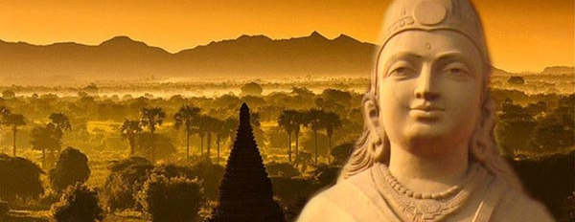
To learn more about this topic read pages 147 thru 151 and complete the section 5 assessment. Show me the completed work when complete.

Slide 5
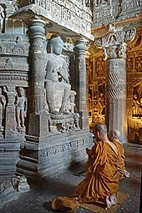
Religious Art
The Mauryan and Gupta periods were a time of magnificent works of art with both Hindu and Buddhist sensibilities. Great temples from both religions were built around India. Some still remain as some of the most beautiful buildings ever made.

Slide 6
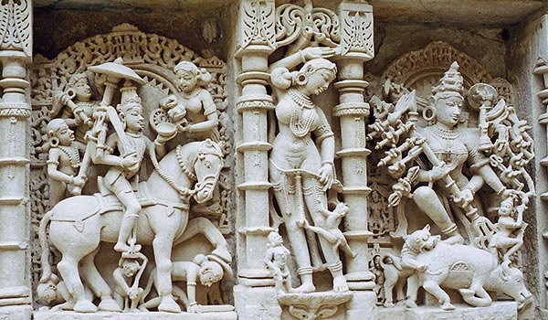
Temples
During Gupta Era, the rock cut architecture reached its zenith and this era marked the beginning of the Free Standing temple Architecture. Most of the temples from this era were carved with representation of Gods and Goddesses. The most important temple of Gupta era is Dasavatar Temple of Deogarh, Uttar Pradesh.

Slide 7
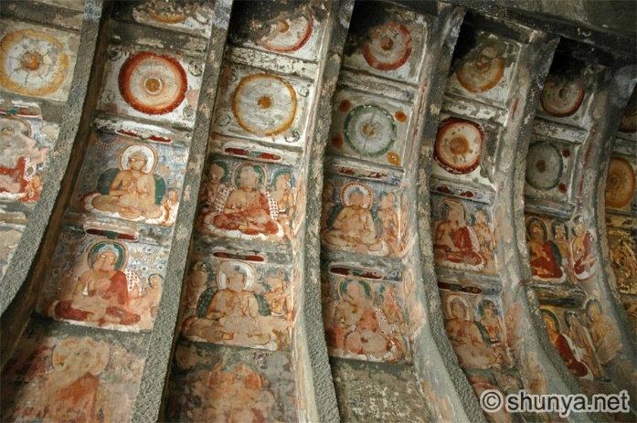
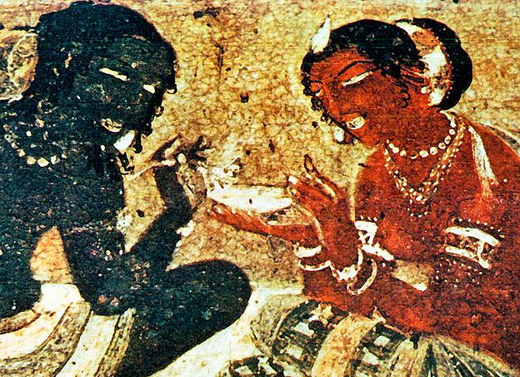
Paintings & Sculptures
The Ajanta and Ellora caves were created during the Golden Age. They were decorated with paintings of religious figures; some Hindu and some Buddhist. Artists were so highly valued that during this time, they were paid for their work — a rare phenomenon in ancient civilizations.

Slide 8
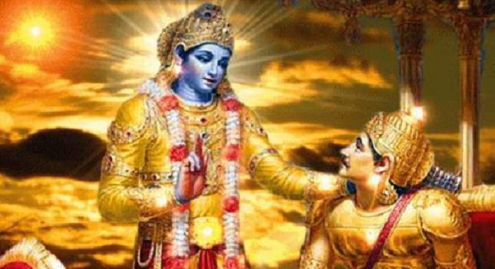
Sanskrit Literature
As you remember, Sanskrit was the language of the Aryans, but during the Maurya and Gupta periods, many works of Sanskrit literature were composed. The greatest of these are two religious epics, the Mahabharata and the Ramayana. The Mahabharata includes the Bhagavad Gita, which is famous for its Brahmanic doctrinal content.

Slide 9
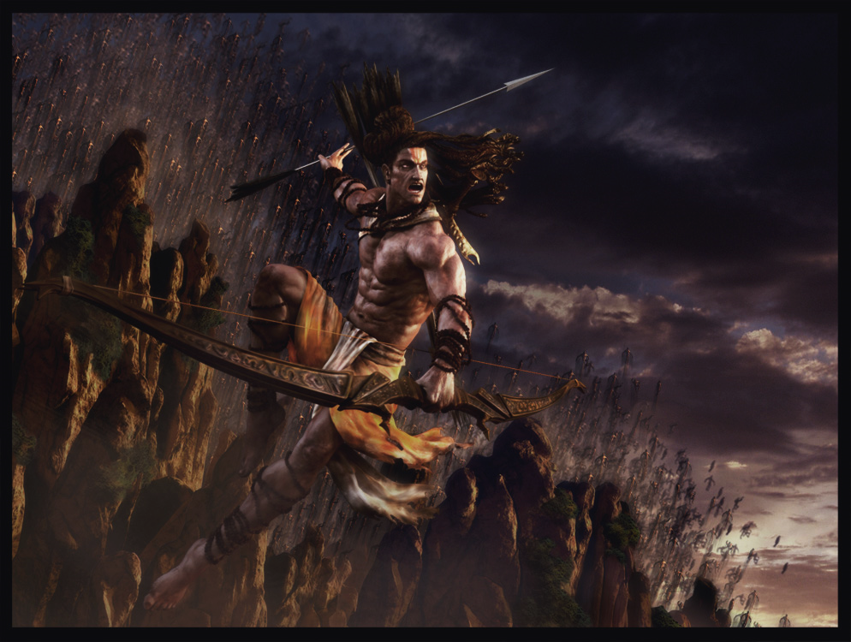
Religious Epics
Ramayana
It is a Sanskrit epic, traditionally attributed to Valmiki, that concerns the banishment of Rama from his kingdom, the abduction of his wife Sita by a demon and her rescue, and Rama's eventual restoration to the throne.

Slide 10
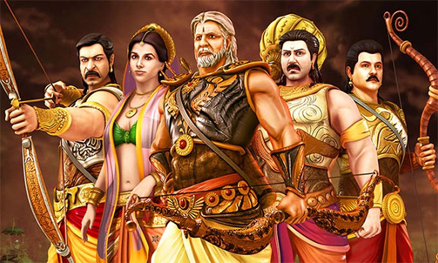
Mahabharata
Is a Sanskrit epic principally concerning the dynastic struggle and civil war between the Pandavas and the Kauravas in the kingdom of Kurukshetra about the 9th century BC, and containing the text of the Bhagavad-Gita, numerous subplots, and interpolations on theology, morals, and statecraft.

Slide 11
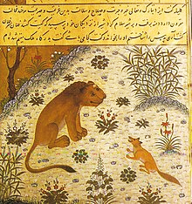
Other Works
During this period, one of India's most influential contributions to world literature, the Panchatantra, consisting of five books of animal fables and magic tales (some 87 stories in all) that were compiled, in their current form. It has been compared to The Grimm's Fairy Tales

Slide 12
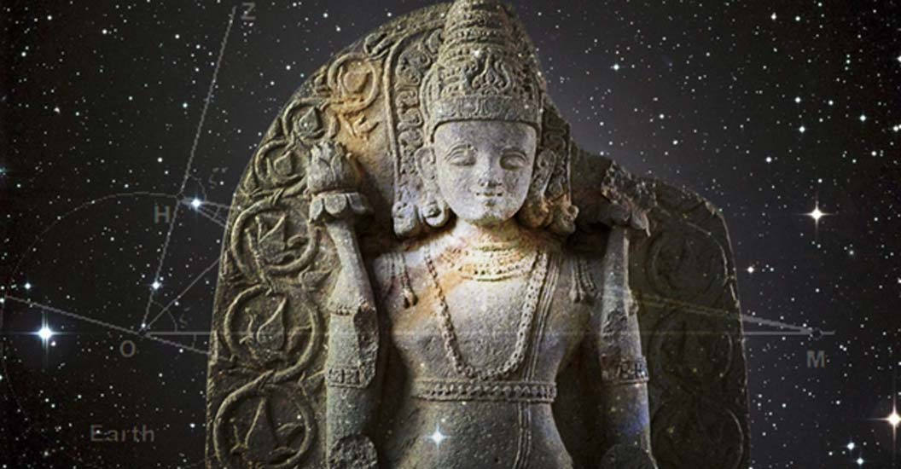
Scientific Advances
Indian achievements were not limited to art, architecture and literature. Advances were also made in metalworking, math and sciences.

Slide 13
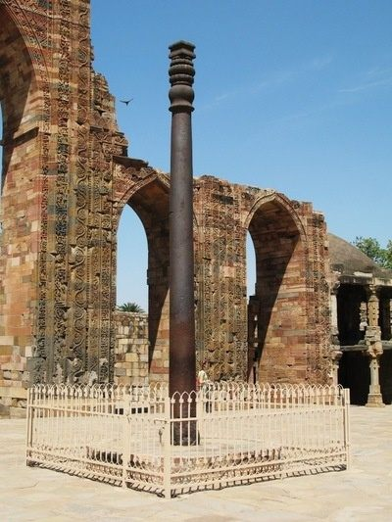
Metallurgy
India was a great metallurgical center since antiquity. India was the first country to develop production of Zinc.
Indians learned metallurgy, or the science of working with metals, to create alloys, or the mixture of two or more metals. Alloys are sometimes stronger or easier to work with than pure metals. Indians were also producers of high quality iron, which made it a valuable trade item.

Slide 14
Math, Medicine & Astronomy
Gupta scholars also were among the most advanced mathematicians of their day. They developed many
elements of our modern math system.
The numbers we use today are called Hindu-Arabic numerals because they were created by Indian scholars and brought to
Europe by Arabs. The Indians were the first people to create the zero. Although it may seem like nothing, modern math wouldn’t be possible without the zero.

Slide 15
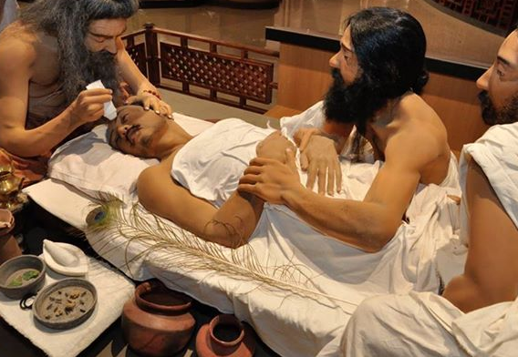
Ancient Indians were also very skilled in the medical sciences. Besides curing people with medicines, Indian doctors knew how to protect people against disease. They practiced inoculation, or injecting a person with a small dose of a virus to help him or her build up defenses to a disease. By fighting off this small dose, the body learns to protect itself.

Slide 16
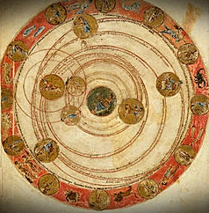
Indian interest in astronomy, the study of stars and planets, dates back to early times as well. Indian astronomers knew of seven of the planets in our solar system. They knew that the sun was a star and that the planets revolved around it. They also knew that the earth was a sphere and that it rotated on its axis. In addition, they could predict eclipses of the sun and the moon!

Slide 17
Final thoughts
From a group of cities on the Indus River, India grew into a Major empire whose people made great achievements.

Slide 18
Assessment
Complete the Chapter 6 Review from pages 155-156.
Complete the Chapter 6 Standardized Test Practice from page 177.

Slide 19
NEXT
china
Jim Soto © 2018

