Slide 1
Q2
Response Paragraph
Jim Soto

Slide 2
Lesson Objective
Understanding the content and structure of a response paragraph
Choose a character from a story or novel to write about
Plan, draft, revise, and edit a response paragraph
Pages 283-286

Slide 3
What is a Response Paragraph?
A Response paragraph is a summary or a reaction to something the writer has read.
Always remember that a paragraph contains a topic sentence, the body, and a closing sentence.

Slide 4
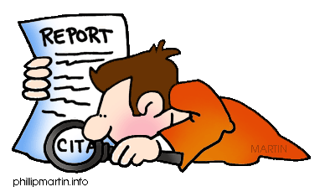
Let’s Give it a Try...
Take two minutes to read and think about the introduction on page 283.
Do you think you can describe your favorite character in just one paragraph, even if the author used many pages to develop that character? Yes, you can!

Slide 5
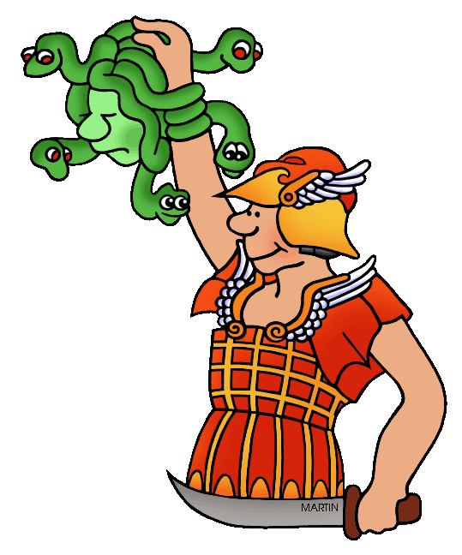
Let’s Give it a Try...
The goal is to “boil down” the information by describing only the basic qualities that make that character interesting and to show how the character changes. That is how you can capture the character in just one paragraph.

Slide 6
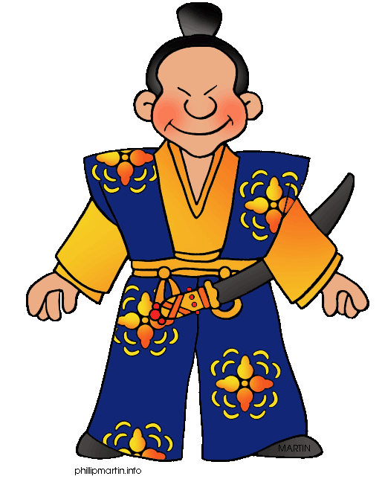
Let’s Give it a Try...
Read Moon Shadow on page 284, then you’ll have five minutes to respond as per the Respond to the Reading assessment at the bottom of the page.
A discussion will follow.

Slide 7
Time to Get Our Feet Wet...
Read pgs. 285-286 to gain a clearer understanding about writing responses. Begin composing one in your notebook using the writers process and the instructions provided.

Slide 8
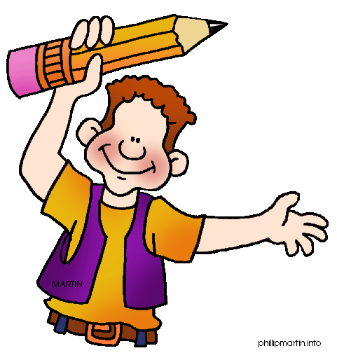
Homework
In your Skills Book complete pgs. 92-96.
Sentence Fragments
Comma Splices & Run-Ons 1
Comma Splices & Run-Ons 1
thanks!

Slide 9
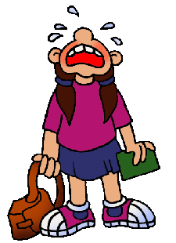
Next
Responding: Writing a Book Review
Jim Soto © 2015

