Slide 1
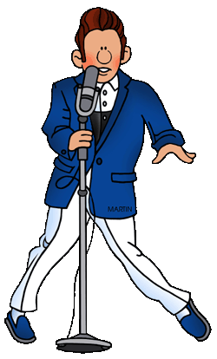
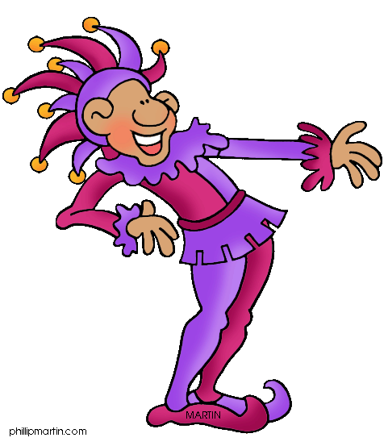
Q2
More Expository Essays
Jim Soto

Slide 2
Lesson Objective
Understanding what an expository comparison - contrast essay is
Continue planning, drafting, revising, editing, and publishing an expository essay to explain similarities and differences
Pages 177-192

Slide 3
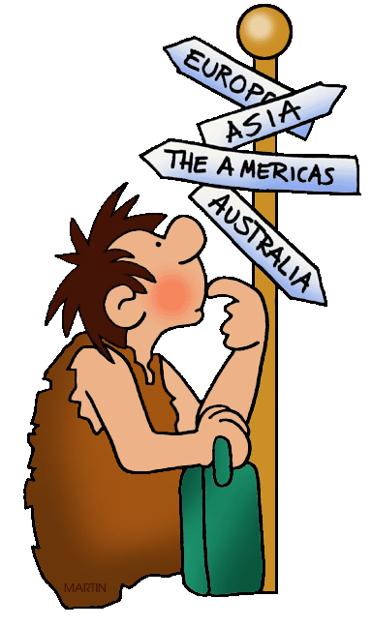
Revising: Transitions
All writing should read smoothly and move logically from one point to the next. Transitions or linking words perform an important function in writing. They signal to the reader the direction the writer is taking. They do this by connecting or linking ideas within a paragraph and providing a bridge between paragraphs.

Slide 4
Revising: Transitions
A transition between paragraphs can be a word or two (however, for example, similarly), a phrase, or a sentence. Transitions can be at the end of the first paragraph, at the beginning of the second paragraph, or in both places.

Slide 5
Revising: Transitions
When writing a paragraph or essay, just as proper grammar and spelling are important, paragraph transitions are also important. Transitional words and phrases connect sentences and paragraphs to each other. Paragraph transitions suggest a particular relationship between one idea and the next.

Slide 6
Common Transitions Include...
To show addition: additionally — also — finally — lastly
To show time: about — after — before — meanwhile
To show location: above — across — beneath — throughout
To show comparison: also — as — like — likewise

Slide 7
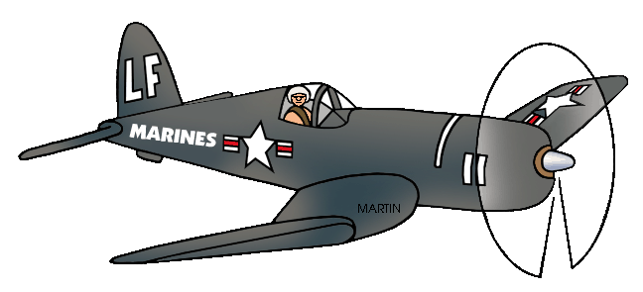
Editing: Conventions
Don’t forget that editing is very important. The rules of punctuation, capitalization, spelling, and grammar aren’t meant to be broken (even if you've made a habit out of it). Use the check list in page 192.

Slide 8
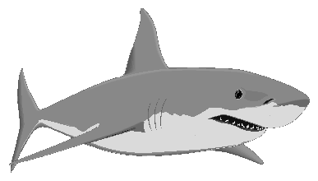
You’ve Been Served!
Continue writing your comparison/contrast expository essay about animals using the point by point method. Read pages 177-192 to learn more writing tips and continue your essay. You will prepare the last two steps of your next essay. Complete the exercises at the bottom of pages 178-188 and 190-191.

Slide 9
Homework
In your Skills Book complete pgs. 85-91.
Adjective Phrases
Appositive Phrases
Transitions
Paragraph-to-Paragraph Coherence
Joy!

Slide 10
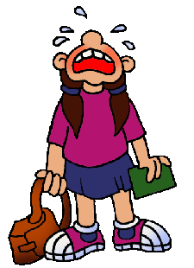
Next
Responding
Jim Soto © 2015

