Slide 1
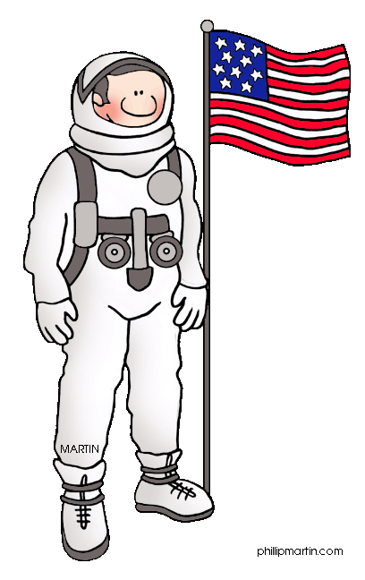
Q2
Writing an Expository Essay
Jim Soto

Slide 2
Lesson Objective
Understanding the content and structure of an expository paragraph
Understanding what an expository comparison - contrast essay is
Planning, drafting, revising, editing, and publishing an expository essay to explain similarities and differences
Pages 161-176

Slide 3
What is an Expository Essay?
An expository essay provides information to explain a topic. Many things can be explained by comparing and contrasting them.
She’s a China girl.
She a White girl.

Slide 4
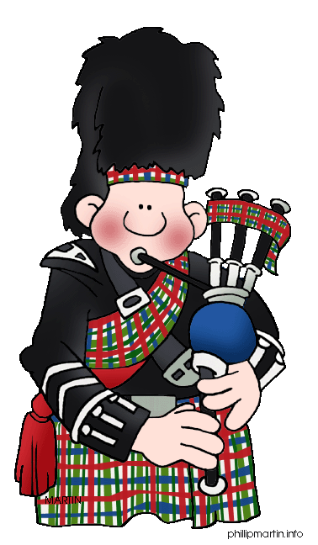
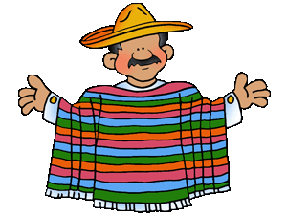
Traits of Comparison-Contrast Writing
Remember the traits! Three traits that relate to the development of the content and the form and that provide a focus during the writing process are:
IDEAS
ORGANIZATION
VOICE

Slide 5
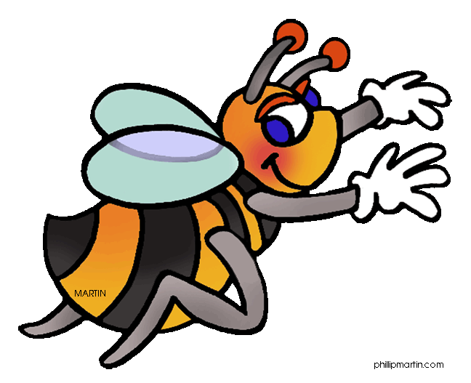
Read an Expository Essay
To better understand how they work lets take three minutes to read the compare-contrast essay, “What’s the Buzz?”, and then write down one point you noticed about:
IDEAS
ORGANIZATION
VOICE

Slide 6
Read an Expository Essay
IDEAS – The writer compares/contrasts two types of insects.
– Details deal with physical traits, diet, and habitats.
ORGANIZATION – The comparison/contrast is done using the oooooooooooooooopoint by point method.
VOICE – The writer sounds confident and knowledgeable.

Slide 7
Organization: Point by point
The Point by point method (also called the slice or alternating method) compares the items one point at a time. The topic sentence focuses on the point being used as the basis of comparison rather than the item.

Slide 8
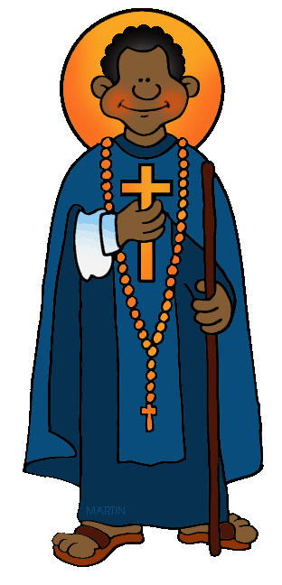
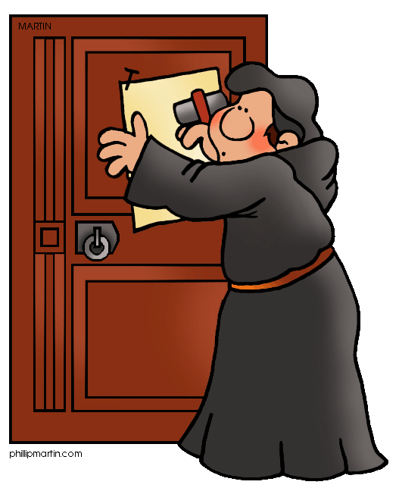
You’ve Been Served!
Writing a comparison/contrast expository essay using the point by point method will be your new task. Read pages 165-176 to get more writing tips and begin your new portfolio entry. You will begin preparing the first three steps of your next essay. Complete the exercises at the bottom of pages 166-170, 173, 175-176.

Slide 9
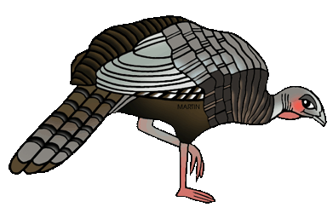
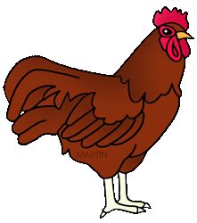
You’ve Been Served!
You'll begin composing an expository essay where two animals of your choice will be compared and contrasted using the point-by-point method. You’ll have four days to turn it in as a portfolio entry.

Slide 10
Homework
In your Skills Book complete pgs. 79-84.
Adjective Clauses
Phrases
Adverb Phrases
high!
Low!

Slide 11
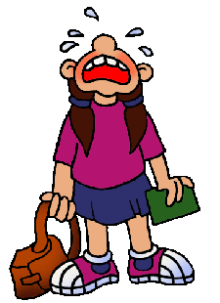
Next
More Expository Writing
Jim Soto © 2015

