Slide 1
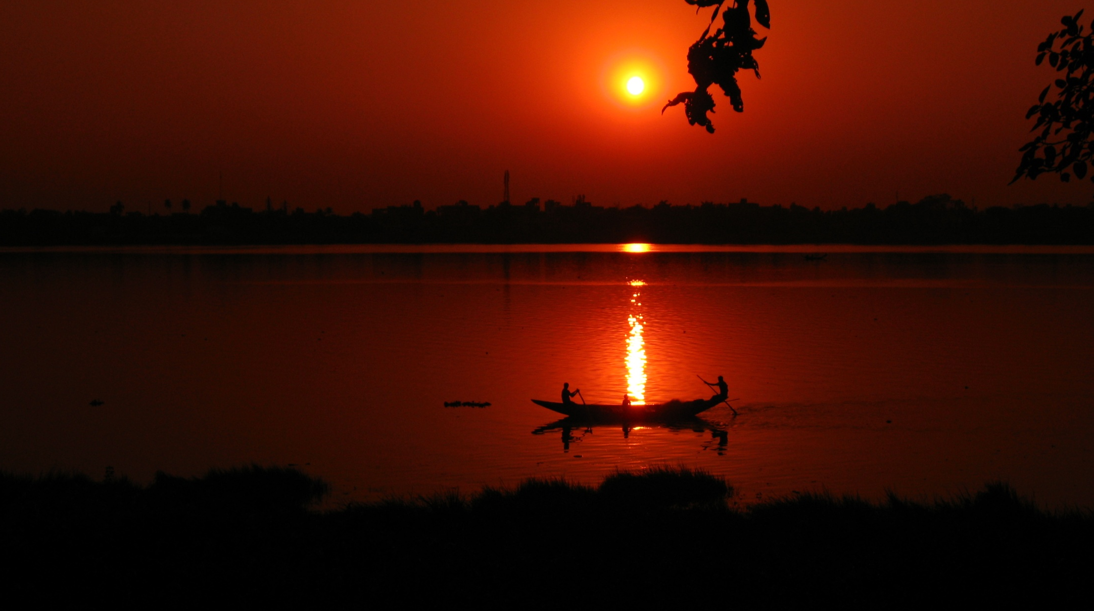
WORLD HISTORY
Geography & Early India
with Mr. Jim Soto

Slide 2
Think...
Your people are nomadic herders in southern Asia about 1200 BC. You live in a river valley with plenty of water and grass for your cattle. Besides looking after cattle, you spend time learning songs and myth from the village elders. They say these words hold your people’s history! One day, it will be your duty to teach them to your own children. Why is it important to pass on these words?
Take a minute to write down your answer.

Slide 3
Like Mesopotamia and Egypt, India was home to one of earth’s earliest civilizations. Like other early civilizations, the one in India formed in a river valley. But the society that eventually developed in India was very different from the ones that developed elsewhere.

Slide 4
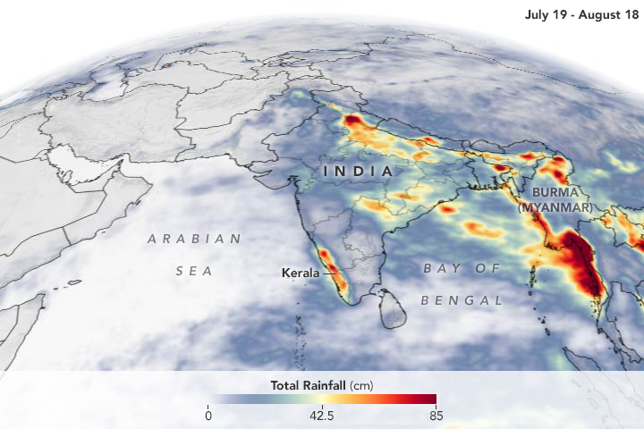
To learn more about this topic read pages 144 thru 149 and complete the section 1 assessment. Show me the completed work when complete.

Slide 5
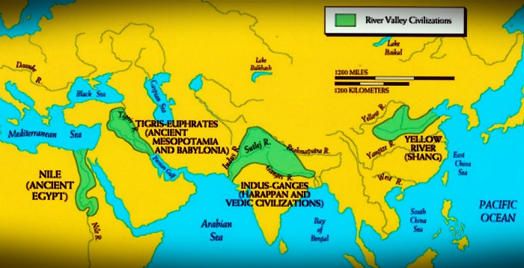
Geography of India
Indian civilization is one of four of what we believe to be the original river valley civilizations.

Slide 6
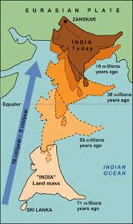
The Indian subcontinent is a southern region and peninsula of Asia, mostly situated on the Indian Plate and projecting southwards into the Indian Ocean from the Himalayas. India is often called a subcontinent because its large landmass.
India is now joined with the continent of Asia, but is a distinct area separated by the Himalayas. Originally it was a separate geologic plate, but has collided and merged with Asia.

Slide 7
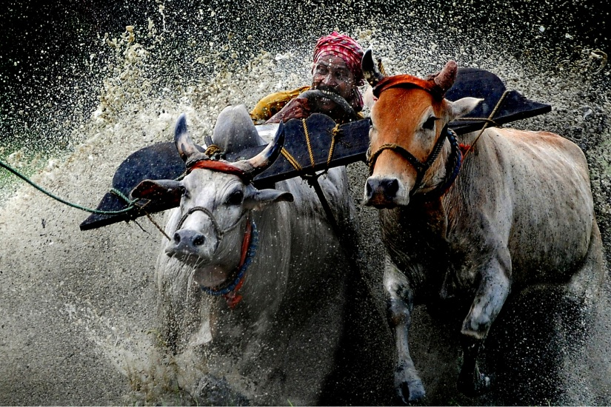
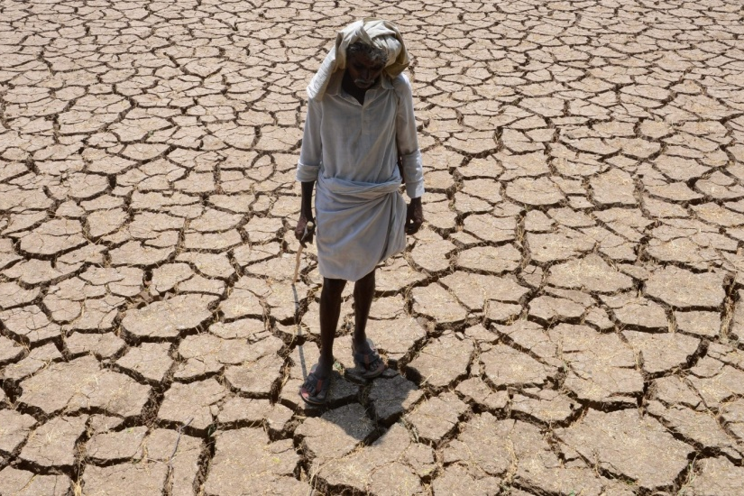
India’s climate is dominated by the monsoons. A monsoon is a seasonal change in the direction of the prevailing, or strongest, winds of a region, causing wet Summer and dry Winter seasons throughout much of the tropics.
Monsoons are most often associated with the Indian Ocean.

Slide 8
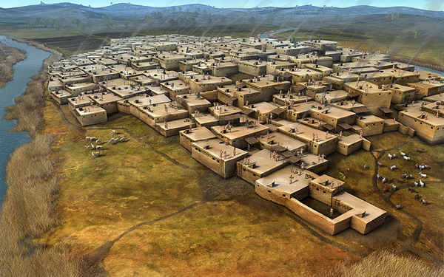
Harappan Civilization
This culture existed along the Indus River in present day Pakistan. Farming settlements began around 4000 BC and around 3000 BC there appeared the first signs of urbanization. By 2600 BC, dozens of towns and cities had been established, and between 2500 and 2000 BC the Indus Valley Civilization was at its peak.
Click Here!

Slide 9
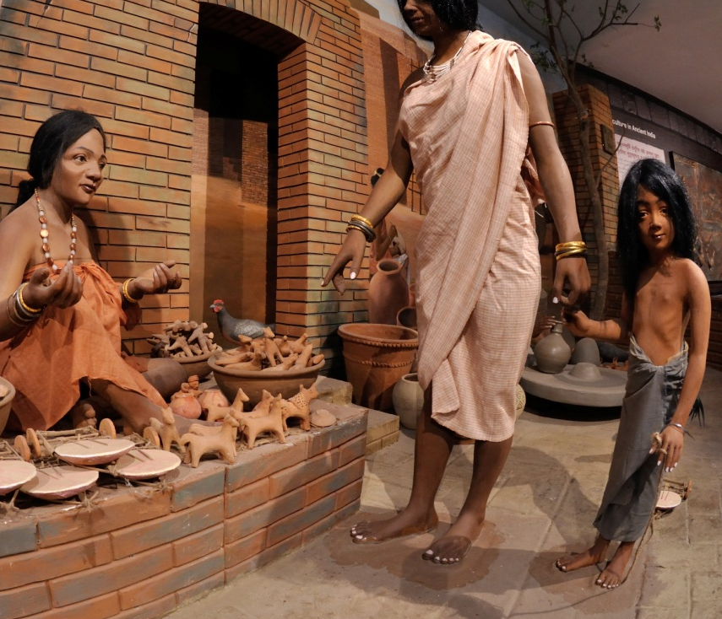
It was named after the city of Harappa which it was centered around. Harappa and the city of Mohenjo-Daro were the greatest achievements of the Indus valley civilization. These cities are well known for their impressive, organized and regular layout. Their building planning was impressive with their bricked streets and right angles.

Slide 10
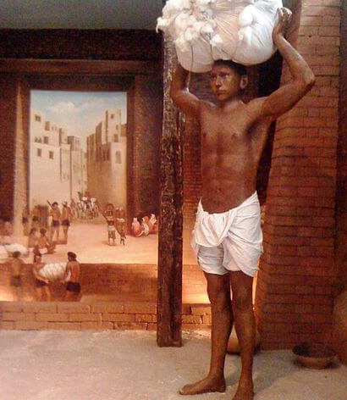
Harappan Achievements
Indus Valley achievements include:
They were first to develop a system of uniform weights and measures.
Their building bricks were very uniform.
The first civilization to incorporate urban sanitation systems.
Agriculture used a highly productive method of raising, storing and transporting domesticated wheat, barley and other crops.
Their empire was economic, not military.

Slide 11
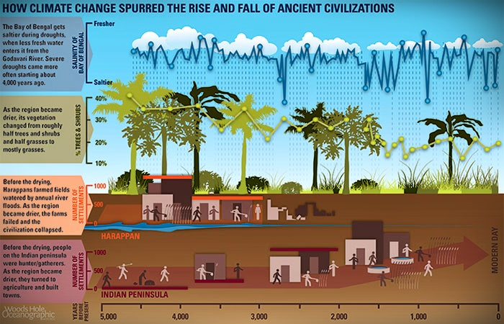
Though the reason of the decline is not known, but through excavations it is clear that fall of the Harappan Civilization occurred between 1800 BC to 1700 BC. A new study provides evidence that climate change was a leading cause of the collapse. The Aryans were the next settlers.

Slide 12
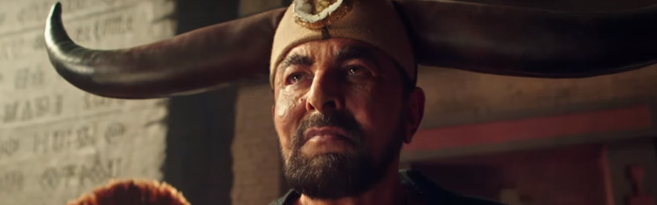
Aryan Invasion or Migration?
One of the most controversial theories about Indian history in the modern ages has been the Aryan Invasion Theory. According to this theory, India was invaded about 1500 BC, by a tribe of European origins called the Aryans.
Click Here!

Slide 13
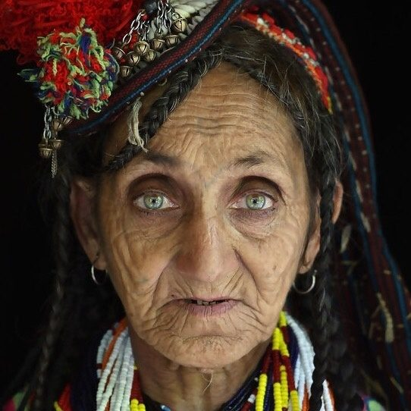
However, evidence suggests that by 1500 BC the Aryans migrated into India from central Asia, not Europe. This large group of nomadic cattle herders crossed the Hindu Kush Mountains and came in contact with the Indus Valley Civilization. This was a large migration and used to be seen as an invasion, which was believed by scholars to be behind fall of the Harappan Civilization; this hypothesis is not unanimously accepted today.
REAL
FAKE

Slide 14
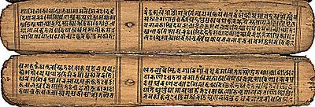
Linguistic studies have shown that as the Aryans migrated into the Indian subcontinent, the Aryan language, Sanskrit, gained ascendency over the local languages. It became the dominant language of India, the one in which the Hindu scriptures and classical Indian epic poems are written.

Slide 15
Final thoughts
The earliest civilizations in India were centered on the Indus Valley.
First the Harappan and then the Aryans lived in this fertile valley.
Sanskrit, the most important language of ancient India is the root of many modern Asian languages.

Slide 16
NEXT
HINDUISM
Jim Soto © 2018

