Slide 1
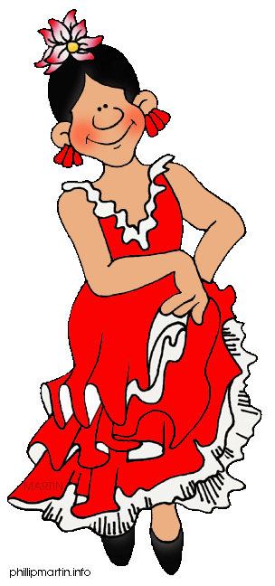
Q2
Writing a Narrative Essay
Jim Soto

Slide 2
Lesson Objective
Understanding personal narratives
Understanding the content and form of personal narratives
Planning, drafting, revising, editing, and publishing personal narratives
Pages 113-129

Slide 3
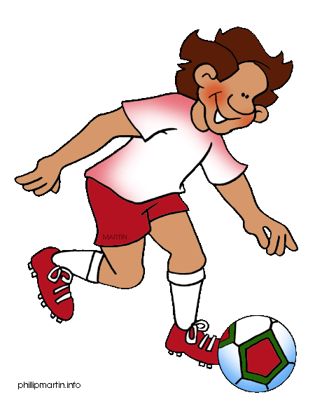
Sharing an Experience
A personal narrative is a story about yourself. It tells about:
what you did,
what happened to you, and
what you learned from the experience.

Slide 4
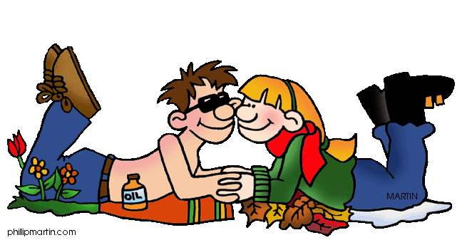
Keep the Flow, Baby...
You began composing a narrative about an experience that taught you something in the last lesson. You’ll continue revising, editing, and publishing this essay to turn in soon.

Slide 5
Keep the Flow, Baby...
When revising:
begin your narrative the best way possible
make sure the order of events is correct
use a variety of sensory details
“show” instead of “tell”
make sure your voice can be heard
finish your narrative in a satisfying way

Slide 6
Keep the Flow, Baby...
When editing ask yourself if you:
punctuated your dialogue correctly
punctuated equal adjectives correctly
spelled the words correctly

Slide 7
Keep the Flow, Baby...
When you publish:
use clear neat hand writing
write your name in the upper left corner
indent all paragraphs

Slide 8
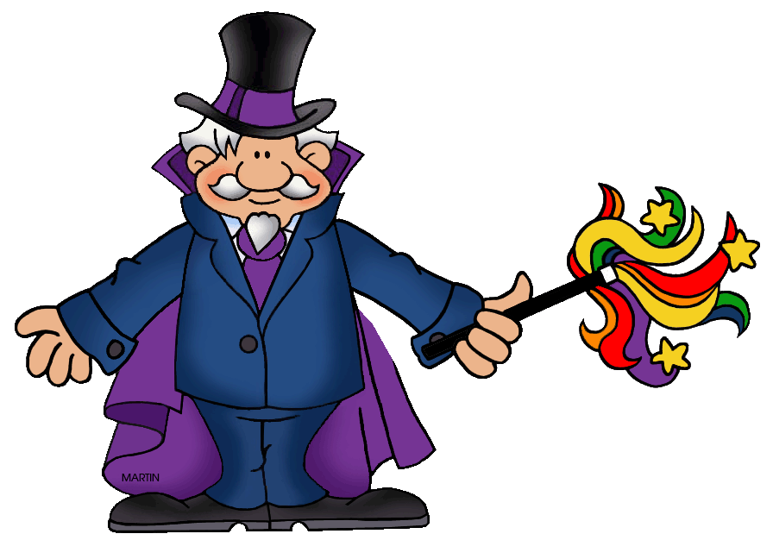
Keep the Flow, Baby...
Continue reading and completing the assessment activities in pgs. 113-129 to get advice on writing your narrative. The activities can be found at the bottom of pages (114-124, 125-127). You will share the results with the class later.

Slide 9
Choose a Theme
Share an experience where you learned something about:
how much you need to “grow”
how much you are loved
how much you have (compared to other less fortunate people)
the importance of things you didn’think were important
the triviality of things you considered important

Slide 10
Seatwork/Homework
Following all five steps of the Writing Process, you will compose an essay using one of the titles from slide #9.
hEh!

Slide 11
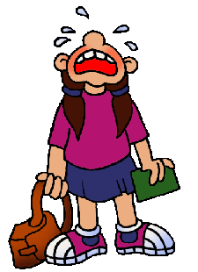
Next
Writing an Expository Paragraph: Comparing Two Things
Jim Soto © 2015

