Slide 1
Writing a Narrative Essay
Jim Soto

Slide 2
Lesson Objective
Understanding personal narratives
Understanding the content and form of personal narratives
Planning, drafting, revising, editing, and publishing personal narratives
Pages 97-112

Slide 3
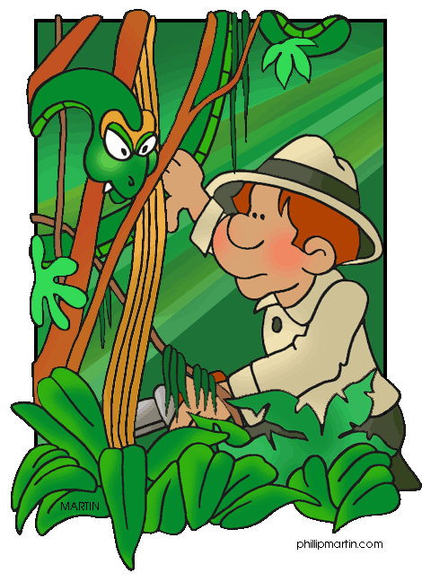
Sharing an Experience
A personal narrative is a story about yourself. It tells about:
what you did,
what happened to you, and
what you learned from the experience.

Slide 4
Sharing an Experience
WHEN I... | I LEARNED...
...helped my best friend...
Some of you may not recognize what you learned from the experience. In that case, make a T-chart in your notebook like this one and start writing:

Slide 5
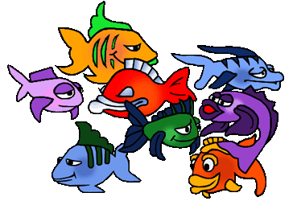
Understanding Your Goals
Your goal is to write an essay about a personal experience that taught you something. Using the traits of writing will help plan, create, and evaluate your personal narrative.

Slide 6
Traits of Narrative Writing
Three traits that relate to the development of both the content and the form of a narrative are:
Ideas
Organization
Voice

Slide 7
The 5 W and H Questions
It’s important to remember that any narrative has to answer the following questions:
Who?
What?
When?
Where?
Why?
How?

Slide 8
Time to Get Our Feet Wet...
Starts in the middle of an action and then gives a back-story.
Beginning
In the narrative titled, Home Team or Visitor? (pg. 99), a student remembers an experience from his first day in middle school. Point out the traits that make it good.
Includes the writer’s feelings and dialogue that connects the action.
Middle
Tells what the writer learned from the experience.
Ending

Slide 9
Time to Get Our Feet Wet...
Take a few minutes to read pgs. 101-112 to get some tips on writing a narrative. Complete the assessment activities in those pages (102-106, 109, 111-112). You will share the results with the class later.

Slide 10
Homework
In your Skills Book complete pgs. 69-72.
Subjects and Predicates 1
Subjects and Predicates 2
Oh,! Oh!

Slide 11
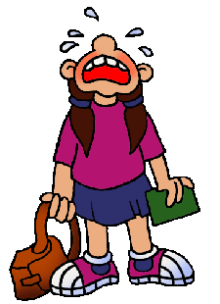
Next
More Narrative Essays
Jim Soto © 2015

