Slide 1
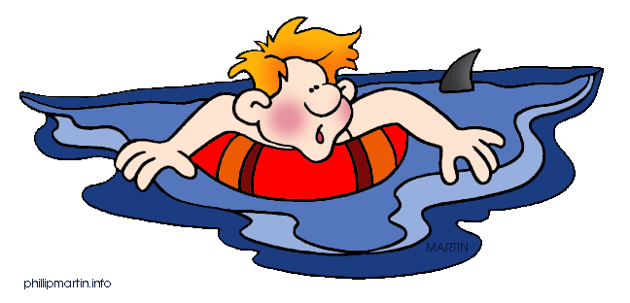
Jim Soto
Writing a
Narrative Paragraph

Slide 2
Lesson Objective
Understand the content and structure of a narrative paragraph
Choose a topic to write about
Use the Writing Process to compose a narrative paragraph
Pages 93-96

Slide 3
What is a Narrative?
Everybody likes a good story. We listen to them. We tell them. People tell them on the road, at the doctor’s office, and at work. We read them in novels and see them in movies. Stories are part of our everyday living.

Slide 4
What is a Narrative?
A narrative is a story. Narratives share important experiences with others. Narrative paragraphs tell a story. Remember that paragraphs usually have a topic sentence, a body, and a closing statement.

Slide 5
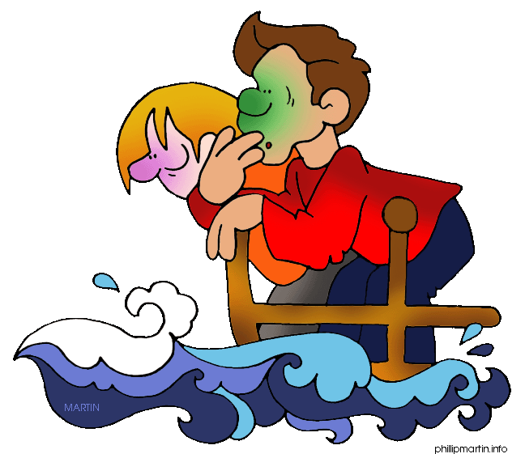
Writing a Narrative Paragraph
Before writing a narrative paragraph, ask yourself:
What stories have you read or seen that describe an exciting experience?
What made the exciting?
What’s you’re purpose in telling the story?

Slide 6
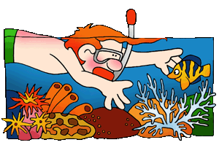
Time to Get Our Feet Wet...
Read pages 93-96 to get more narrative writing tips. Complete all the instructions and exercises at the bottom of these pages. There is a total of six activities to work on.

Slide 7
Homework
In your Skills Book complete pgs. 64-66. Here:
Using the Right Word 3
Using the Right Word 4
Using the Right Word Review ojo**
Happy!

Slide 8
Next
Test #1
Jim Soto © 2015

