Slide 1
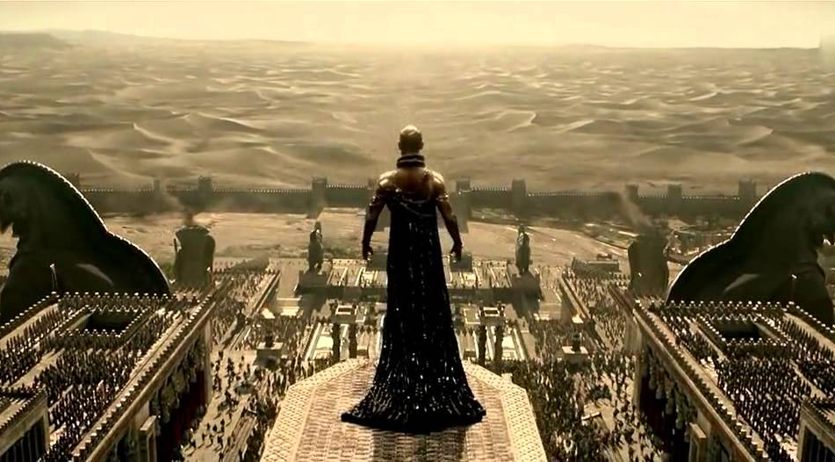
WORLD HISTORY
Later People of the Fertile Crescent
with Mr. Jim Soto

Slide 2
Think...
You are a noble in ancient Babylon, an advisor to the great Hammurabi! One of your duties is to collect all laws of the kingdom. They will be carved on a tall block of black stone and placed in the temple. The king asks your opinion about the punishment for certain crimes. For instance, should common people be punished more severely than nobles?
Take a minute to write it down.

Slide 3
In time, many people invaded Mesopotamia. A series of kings conquered the lands between the rivers. Each new culture inherited the earlier achievements of the Sumerians. Some of the later invasions of the region also introduced skills and ideas that still influence civilization today, such as a written law code.

Slide 4
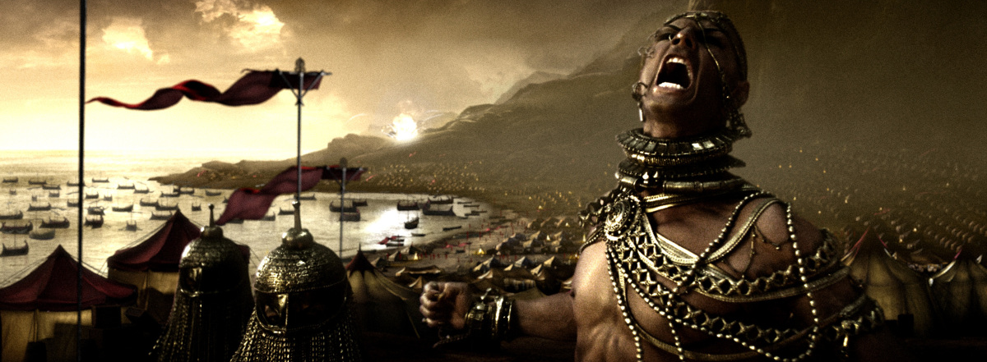
To learn more about this topic read pages 72 thru 77 and complete the section 4 assessment. Show me the completed work when complete.

Slide 5
The Rise of Babylon
Although Ur became the seat of a powerful empire under Sargon, repeated attacks from foreign powers weakened it. By 2000 BC, Ur was no more, and other invaders started gaining control of Mesopotamia. Babylon appeared on the scene.
Click Here!

Slide 6
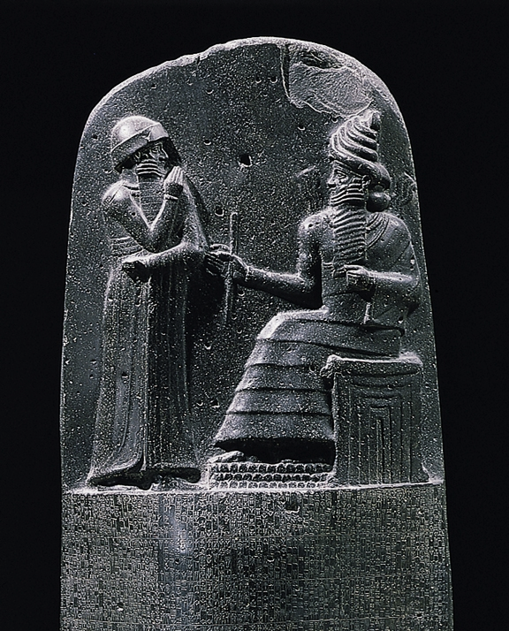
The city of Babylon had been a city-state in Mesopotamia for many years. After the fall of the Akkadian Empire, the city was taken over and settled by the Amorites. The city began its rise to power in 1792 BC when its monarch, King Hammurabi took the throne. A monarch is a ruler of a kingdom or empire.

Slide 7
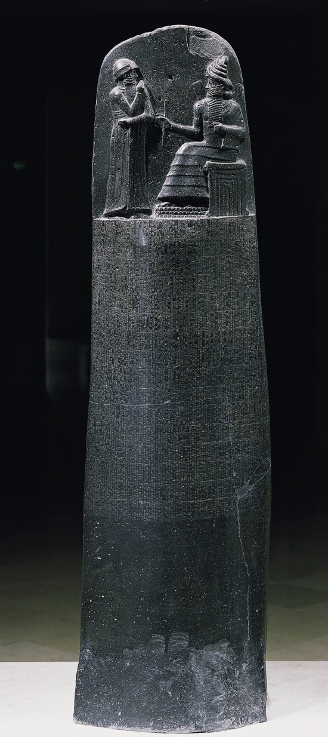
The Code of Hammurabi
The great cultural contribution of Hammurabi was his Code, or system of laws that represent the first attempt to record all laws. It’s a collection of 282 rules, established standards for commercial interactions and set fines and punishments to meet the requirements of justice. Hammurabi’s Code was carved onto a massive, finger-shaped black stone stele (pillar) that was looted by invaders and finally rediscovered in 1901.
Click Here!

Slide 8
"An eye for an eye" or the law of retaliation, is the principle that a person who has injured another person is to be penalized to a similar degree. The principle is referred using the Latin term lex talionis. In the famous legal code of Hammurabi, the principle of exact reciprocity is very clearly used. For example, if a person killed another person, the killer would be put to death.

Slide 9
The Hittites & Kassites Take Over
The Hittites occupied the region of Anatolia (AKA Asia Minor) prior to 1700 BC. They were among the first to master ironworking, which helped them to expand their territories into an empire which took Babylon. Their rule didn’t last long.

Slide 10
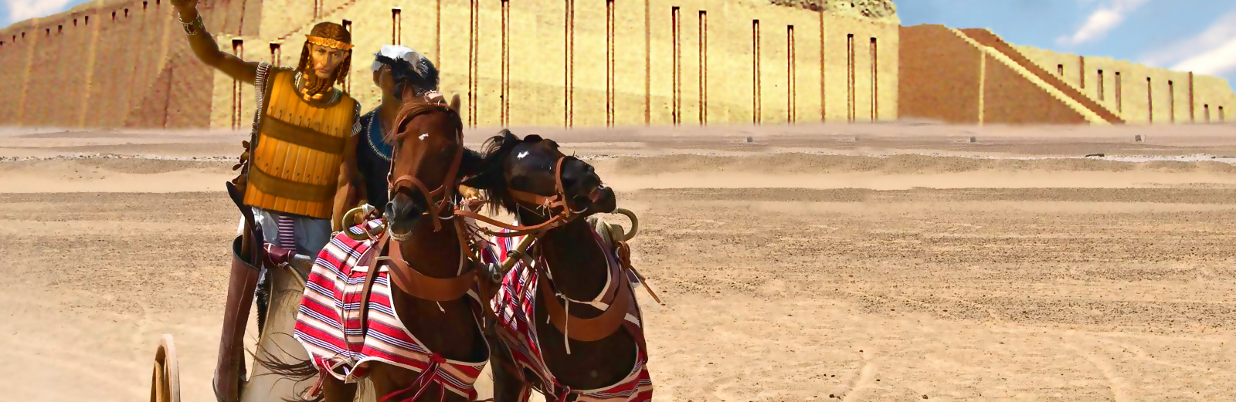
The Kassites were tribal federation living in the Zagros mountains, that controlled Babylon after the fall of the Hittite Empire 1531 BC and until 1155 BC. They ruled Babylon practically without interruption for almost four hundred years—the longest rule by any dynasty in Babylonian history.

Slide 11
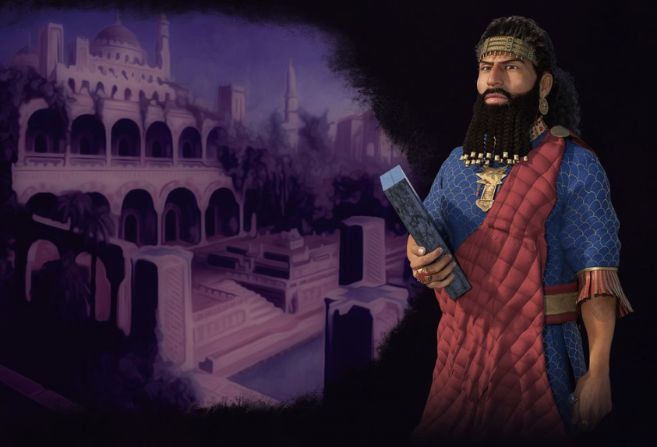
The Assyrians
From 900 to 600 BC, the Assyrian Empire expanded from the city of Nineveh and conquered and ruled Mesopotamia, Egypt, and the eastern coast of the Mediterranean. Since around 1250 BC, they had started using war chariots and iron weapons, which were far superior to bronze weapons. With these tools and their cruel tactics, the Assyrian army became the most powerful military force of its time.
Click Here!

Slide 12
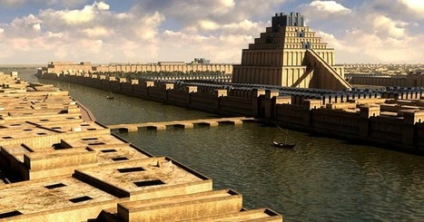
The Chaldeans
Unlike the Akkadians, Assyrians and Babylonians, whose ancestors had been established in Mesopotamia since very early, the Chaldeans were not native Mesopotamians, but were late 10th century BC migrants.

Slide 13
Nebuchadnezzar II, (634-562 BC) was the greatest Chaldean king of ancient Babylon. Under his reign, Chaldean-ruled Babylon became the most powerful city-state in the region, and he, the greatest warrior-king and ruler in the known world. He is portrayed in unflattering light in the Bible, most notably in the Book of Daniel and the Book of Jeremiah.
Click Here!

Slide 14
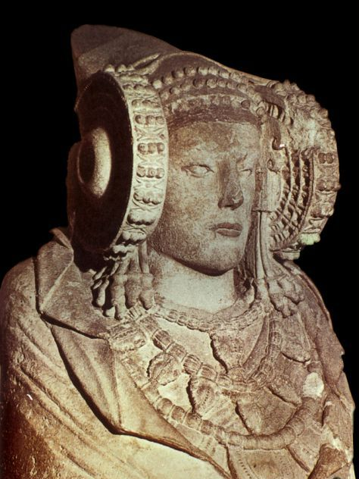
The Phoenicians
The Phoenicians were among the greatest traders of their time and owed much of their prosperity to trade. Phoenicia was an ancient civilization in Canaan which covered most of the western, coastal part of the fertile Crescent. Several major Phoenician cities were built on the coastline of the Mediterranean. They were an enterprising maritime trading culture that spread across the Mediterranean from 1550 BC to 300 BC.
Click Here!

Slide 15
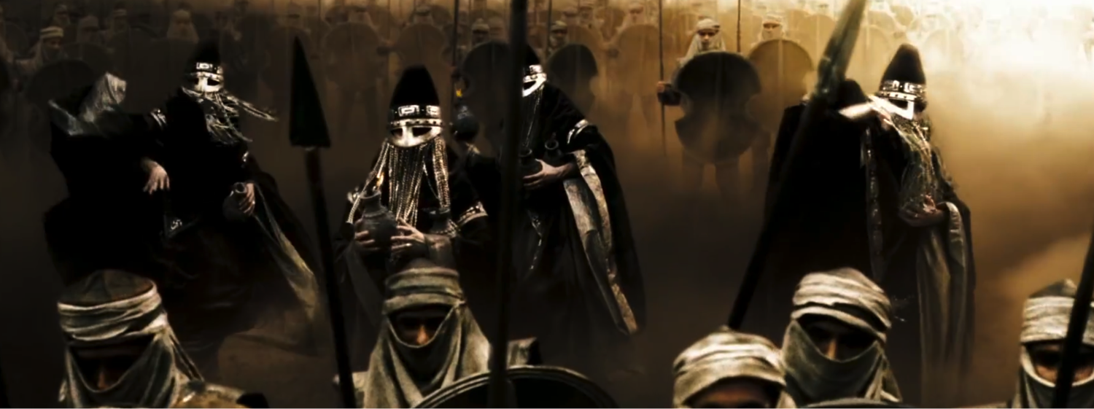
Many different peoples ruled the Fertile crescent after the Sumerians. Some made important contributions that are still valued today.

Slide 16
Final thoughts
The Babylonians conquered Mesopotamia and created a code of law.
Invasions of the Fertile crescent changed the region’s culture.
The Phoenicians built a trading society in the eastern Mediterranean region.

Slide 17
Assessment
Complete the Chapter 3 Review from pages 79-80.
Complete the Chapter 3 Standardized Test Practice from page 81.

Slide 18
NEXT
EGYPT
Jim Soto © 2018

