Slide 1
Constructing Strong Paragraphs
Jim Soto

Slide 2
Lesson Objective
Learn the parts of a paragraph
Learn types of paragraphs
Learn writing effective paragraphs
Add details to paragraphs
Gather, refine, and organize details
Turn paragraphs into essays
Pages 523-539

Slide 3
Parts of a Paragraphs
Topic Sentence
Start with interesting information and state the focus.
Most paragraphs have three main parts that appear in this order: A topic sentence, the body, and a closing sentence.
Present the main supporting points and details about the topic.
Body
Closing Sentence
Review the essay and offer a final thought.

Slide 4
Closer Look at the Parts
The Topic Sentence
The topic sentence tells the reader what a paragraph is going to be about. It should: name the topic and state a specific detail or feeling about it. It is usually the first sentence in the paragraph.

Slide 5
Closer Look at the Parts
The Body
The sentences in the body of the paragraph include the details needed to understand the topic. You can organize the sentences by using : chronological order, location, importance, comparison or logical order.

Slide 6
Closer Look at the Parts
The Closing Sentence
This statement comes after all the details in the body. It often restates the topic, gives the reader something to think about and/or provides a transition to the next paragraph.

Slide 7
Types of Paragraphs
There are four basic types of paragraphs:
Narrative
Descriptive
Expository
Persuasive
Each type requires a different way of thinking and planning.

Slide 8
Types of Paragraphs
Narrative paragraphs - tell a story or a personal experience. They answer : who? what? when? where? and why? A narrative is usually organized in chronological order (what happen first, what happened later, etc...)
Descriptive paragraphs - give detailed pictures of a person, a place, an object, or an event. Sensory details might be heavily used in this type of writing.

Slide 9
Types of Paragraphs
Expository paragraphs - is used to share information. you can give explanations, give directions, or show how something is done. Transition words such as: first, then, or finally are often used.
Persuasive paragraphs - are used to share opinions about a topic. To be persuasive you must include enough reasons, facts, and details to support your opinion.

Slide 10
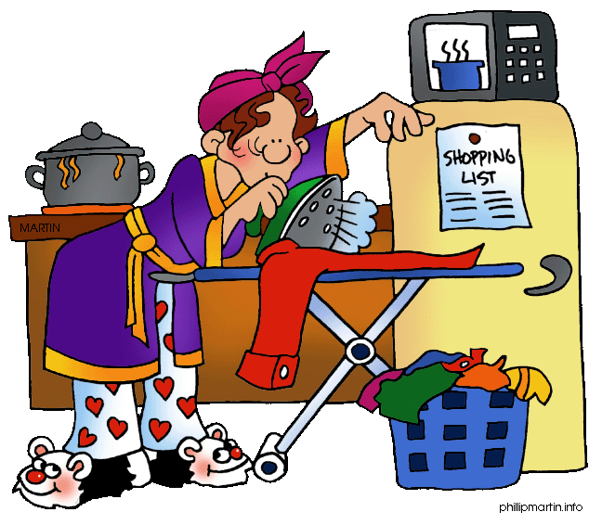
Writing Effective Paragraphs
Remember that in order to write effectively, one must use the writing process and personal details that include the senses, memories, and personal reflections.

Slide 11
Read more about Writing
Writing is a highly detailed, and highly structured endeavor. Read pages 523-539 to get more writing tips. Complete the exercises at the bottom of pages 524,526 - 529, and, 534 - 539.

Slide 12
Homework
In your Skills Book complete pgs. 59-63.
Spelling and Plurals
Using the Right Word 1
Using the Right Word 2
heh!

Slide 13
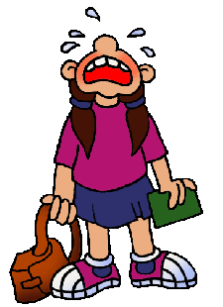
Next
Listening and Speaking
Jim Soto © 2015

