Slide 1
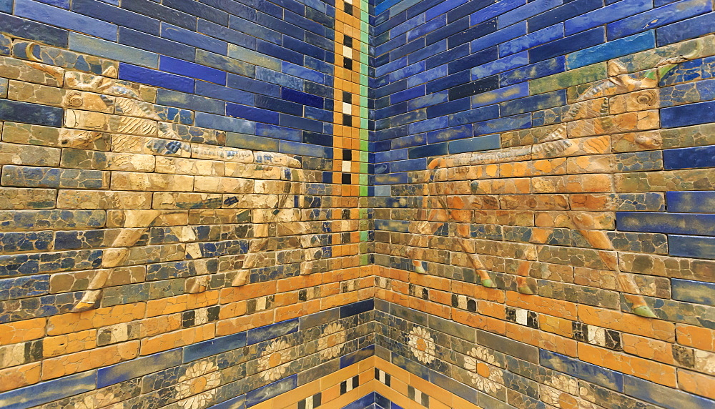
WORLD HISTORY
Sumerian Achievements
with Mr. Jim Soto

Slide 2
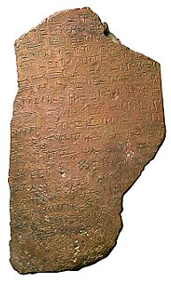
Think...
You are a student in a Sumerian school for scribes. Learning all the symbols for writing is hard. Your teacher assigns you lessons to write on your clay tablet, but you keep making mistakes. Then you have to smooth out the surface and try again. Still, becoming a scribe can land you an important job at the royal court. It could bring prestige to your family. Why would you want to be a scribe?
Take a minute to write down your answer.

Slide 3
There is no question that Sumerians were very advanced politically and religiously. However, Sumerians were responsible for many other achievements that were passed down to later civilizations.

Slide 4
Interestingly enough, the Sumerians claimed that many of the inventions we attribute to them, were actually ‘gifts’ from the gods.
To learn more about this topic and others, read pages 65 thru 69 and complete the section 3 assessment. Show me the completed work when complete.

Slide 5
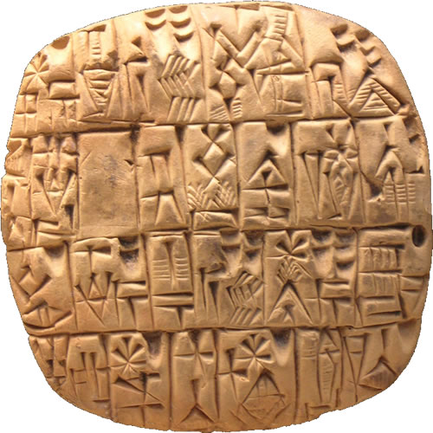
The Invention of Writing
Sumerian cuneiform is the earliest known writing system. Its origins can be traced back to about 8,000 BC and it developed from the pictographs, or picture symbols to symbols used to represent syllables and even words.
Scribes (writers), were hired to keep business records, official decrees and eventually, the creation of literary works.

Slide 6
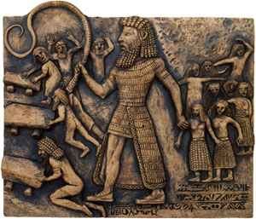
Some of these were the Epics, long poems that tell stories of heroes.
The Epic of Gilgamesh is an example of one such work.

Slide 7
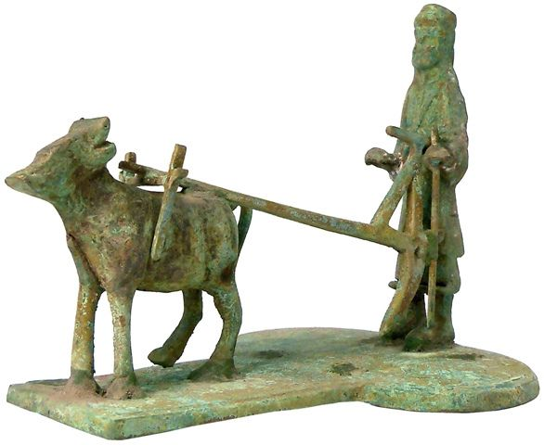
Technical Advances
Sumerians made many other advances and discoveries. Sumerians were responsible for:
The wheel
The wagon
The potter’s wheel
The plow
The water clock
The sewer
Makeup.

Slide 8
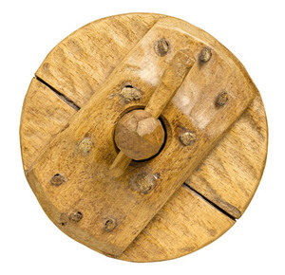
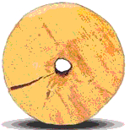
The Wheel
The first wheels were not used for transportation. Evidence indicates they first served as potter's wheels around 3500 BC in Mesopotamia—300 years before someone figured out to use them for chariots. Even after figuring this out, people still relied on camels for transportation. In the Middle East, wheels were mainly used for domestic purposes like pottery, irrigation, and milling.
Click Here!

Slide 9
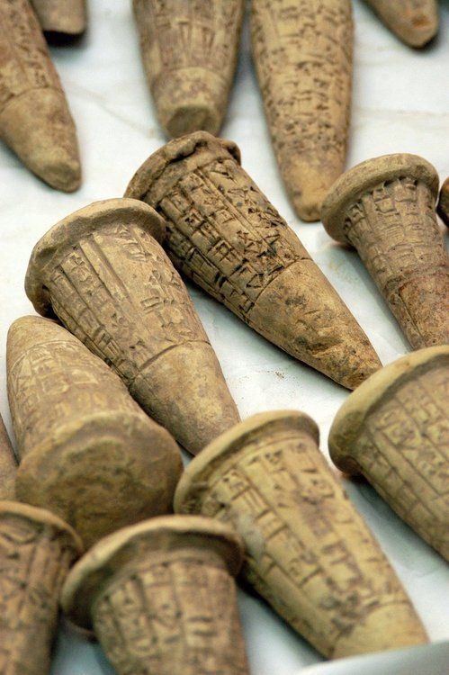
Math & Sciences
Sumerians also made important advances in math. Sumerians developed a system based on the number 60. Because of this they could divide a circle into 360 degrees.
Dividing a year into 12 months (a factor of 60) was another of their achievements.
Sumerians contributions to medicine include using natural ingredients to make drugs and listing treatments according to symptoms and body parts.

Slide 10
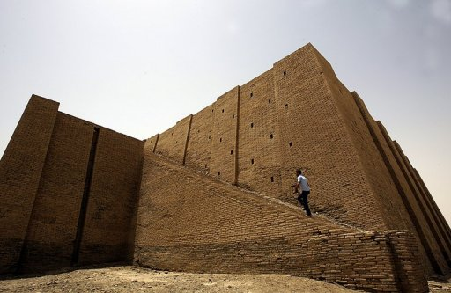
Architecture
Architecture, or the science of building, was another area of remarkable skill in which Sumerians excelled.
Their cities were dominated by large impressive ziggurats, a type of pyramid-shaped temple tower, that rose above each city.
Click Here!

Slide 11
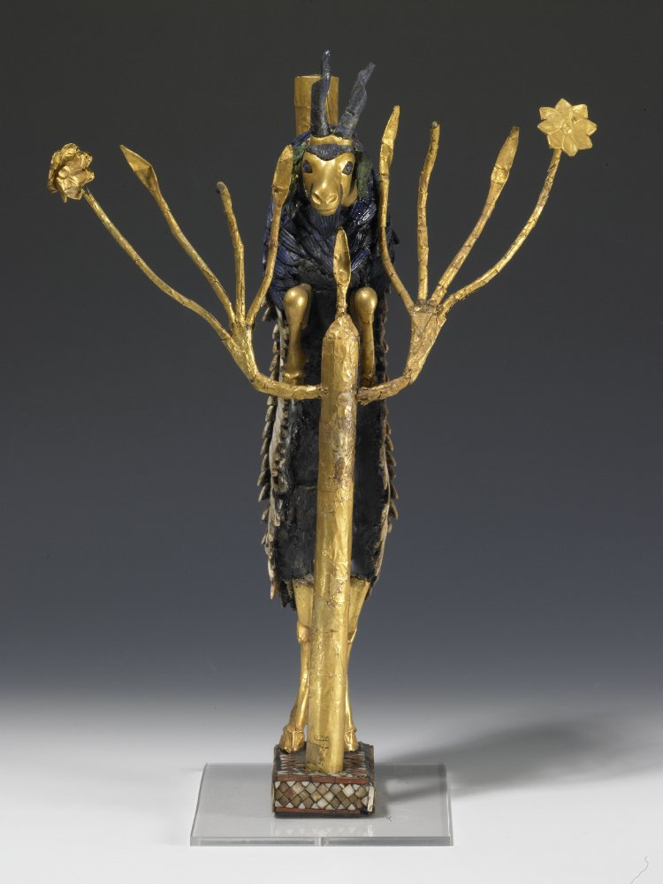
The Arts
Sumerian artists produced exquisite works of art using ivory and rare woods. Pottery, however, was not their best.
Jewelry was very popular and they made beautiful earrings and necklaces out of gold, silver and precious stones.
Cylinder seals are among their most famous works.
Sumerian also enjoyed music and invented instruments such as: reed pipes, drums, tambourines and lyres.
Click Here!

Slide 12
Final thoughts
Sumerians invented the world’s first writing system.
Advances and inventions that changed Sumerian’s lives also changed the course of history.
Many types of art were developed in Sumer.

Slide 13
NEXT
THE OTHERS
Jim Soto © 2018

