Slide 1
Descriptive Essay
Jim Soto

Slide 2
Lesson Objective
Learn how to write a classified ad
Pages 90-91

Slide 3
Classified Ads
Classified ads are an important part of everyday life in Puerto Rico. People looking to sell their “stuff” use them. People looking to buy “stuff” also use them.

Slide 4
Classified Ads
Classified ads appear in newspapers, magazines, and also online. The descriptions of items on sale have to be detailed, as if tto help the reader visualize what the item looks like.
Have you or someone you know visited Clasificados Online Puerto Rico.com?

Slide 5
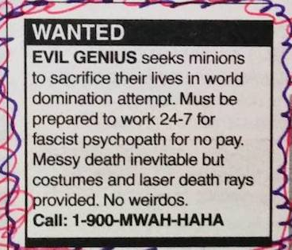
Creating a Classified Ad
Some ads look like this:

Slide 6
Creating a Classified Ad
Checkout page 90 to see the different elements that are part of making an ad.

Slide 7
Creating a Classified Ad
Now practice for the next 15 minutes in your notebook writing a classified ads for the sale of a puppy or a kitten. Show it to the teacher and share it with your peers.

Slide 8
Creating a Classified Ad
Go to page 91 and read it. Apply the writing tips provided there and do the Try IT activity at the bottom of the page. Turn it in when completed.

Slide 9
Homework
In your Skills Book complete pgs. 49-54.
Capitalization 1
Capitalization 2
Abbreviations and Numbers
drat!

Slide 10
Next
Constructing Strong Paragraphs
Jim Soto © 2015

