Slide 1
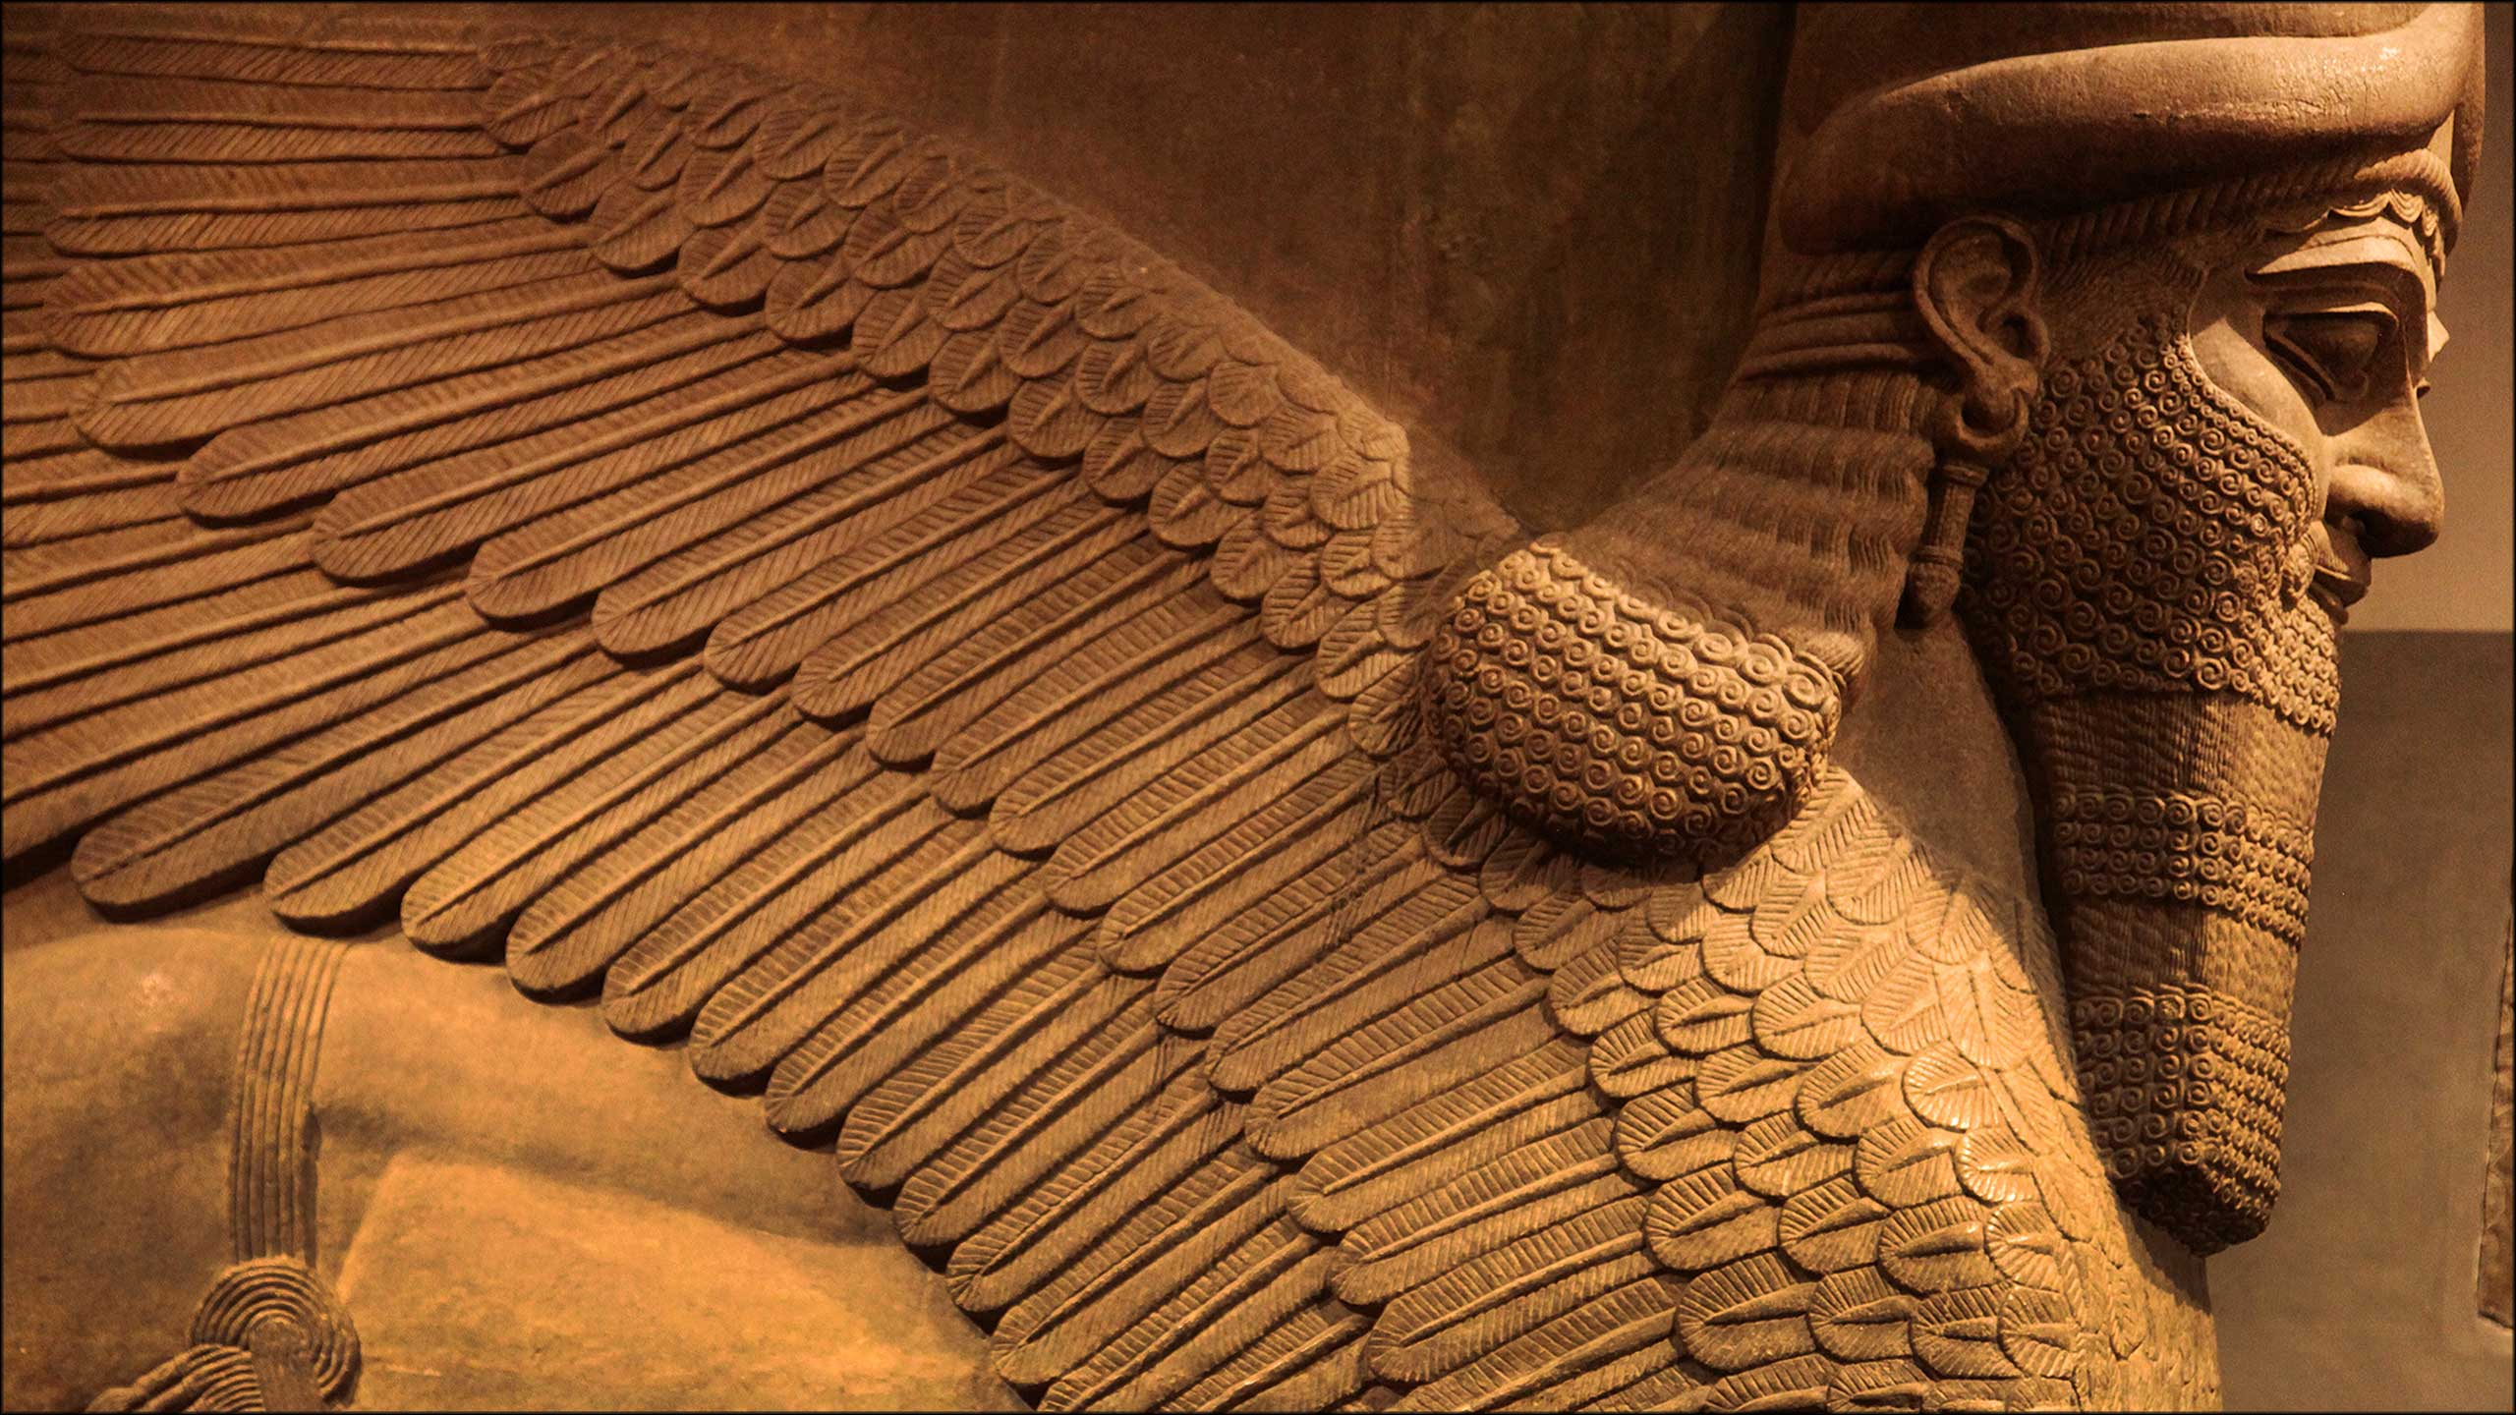
WORLD HISTORY
The Rise of Sumer
with Mr. Jim Soto

Slide 2
Think...
You are a crafter living in a Sumerian city. Thick wall surround and protect your city, so you feel safe from the armies of other city-states. But you and your neighbors are fearful of other beings – the many gods and spirits that you believe are everywhere. They can bring plagues, or sandstorms, or bad luck. How might you protect yourself from them?
Take a minute to write down your answer.

Slide 3
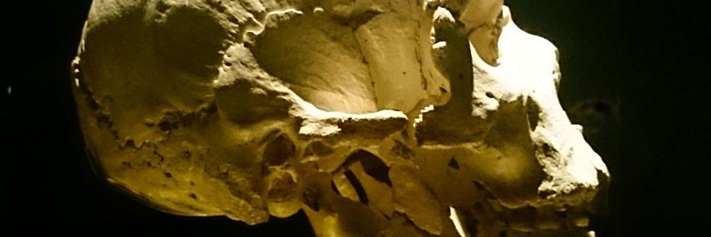
Evidence suggests that humans have been religious beings since the beginning. In Atapuerca in Spain, over 32 individuals were found at the bottom of a deep shaft. A possible interpretation is that they were intentionally buried. Burials have religious connotations.

Slide 4
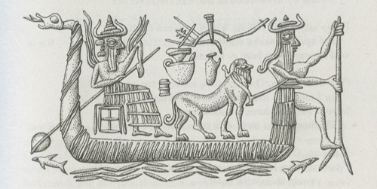
We can interpret the burials as a concern for the spirits of the deceased or as a method to ease their transition to the afterlife.
To learn more about this topic and others, read pages 60 thru 64 and complete the section 2 assessment. Show me the completed work when complete.

Slide 5
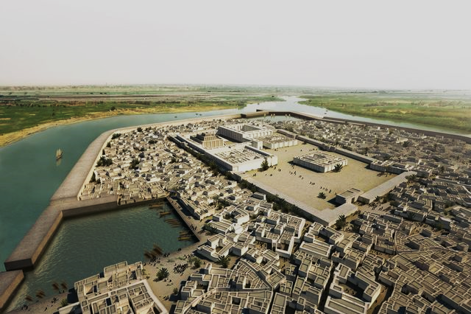
The City-States of Sumer
Most Sumerians were farmers. They lived in rural areas, or the countryside. The centers of society, however, were in urban, or city areas. Sumerian cities at one time had as much as 100,000 residents.
This resulted in the first political unit: the city-state, consisting of a city and the countryside around it.

Slide 6
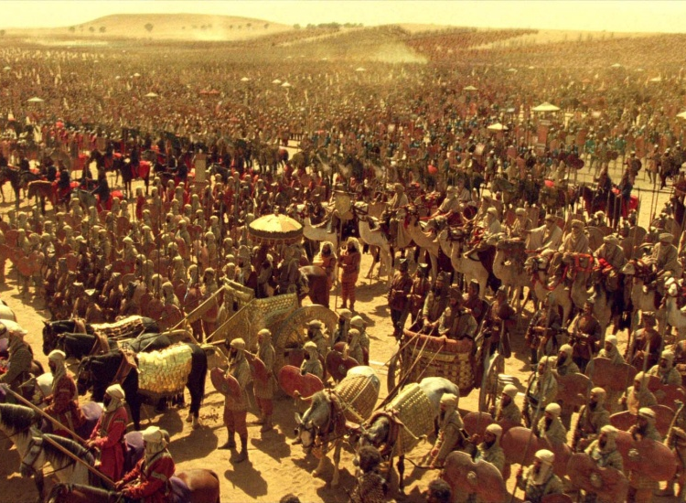
By 3,500 BC Kish was the most powerful city-state, while upstarts such as Uruk and Ur battled for dominance for over 1,000 years.
Uruk is most famous for its great king Gilgamesh and the epic tale of his quest for immortality but also for a number of `firsts' in the development of civilization which occurred there.

Slide 7
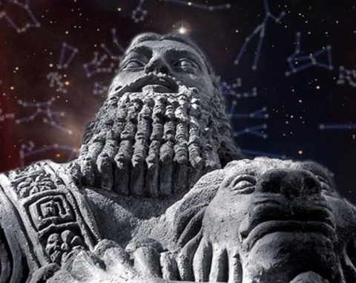
Gilgamesh
Written in cuneiform around 1300 BC, “The Epic of Gilgamesh” was one of the most beloved stories of Mesopotamia. According to the tale, Gilgamesh is a handsome, young king of Uruk.
In the first half of the story Enkidu, a wild man is sent by the gods to stop Gilgamesh from oppressing the people of Uruk. In the second half, distress about Enkidu's death causes Gilgamesh to undertake a perilous journey to discover the secret of eternal life.
Click Here!

Slide 8
Rise of the Akkadians
The first Empire to rule all of Mesopotamia was the Akkadian Empire. It lasted for around 200 years from 2300 BC to 2100 BC. The Akkadians lived in northern Mesopotamia while the Sumerians lived in the south. They had a similar government and culture as the Sumerians, but spoke a different language.

Slide 9
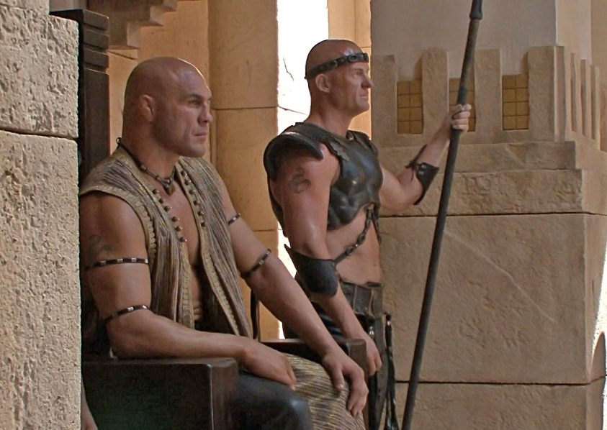
In 2300 BC, Sargon, the ruler of Akkad in Mesopotamia from 2340 to 2305 B.C., and is credited with creating the world's first known empire, or land with different territories and people under a single rule. He achieved this by conquering all of southern and northern Mesopotamia and bringing it under his rule. His empire stretched from the Persian Gulf to the Mediterranean Sea.
Click Here!

Slide 10
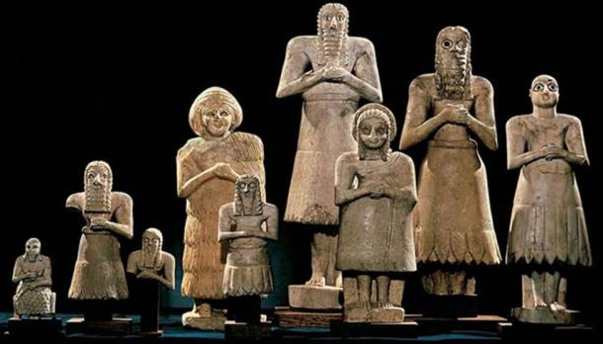
Sumerian Religion
The Sumerians were polytheistic, they worshipped many gods.
The Sumerians believed that the universe had come into being through a series of cosmic births. First, Nammu, the primeval waters, gave birth to An (the sky) and Ki (the earth), who mated and produced a son named Enlil.
Let’s see their Creation myth.
Click Here!

Slide 11
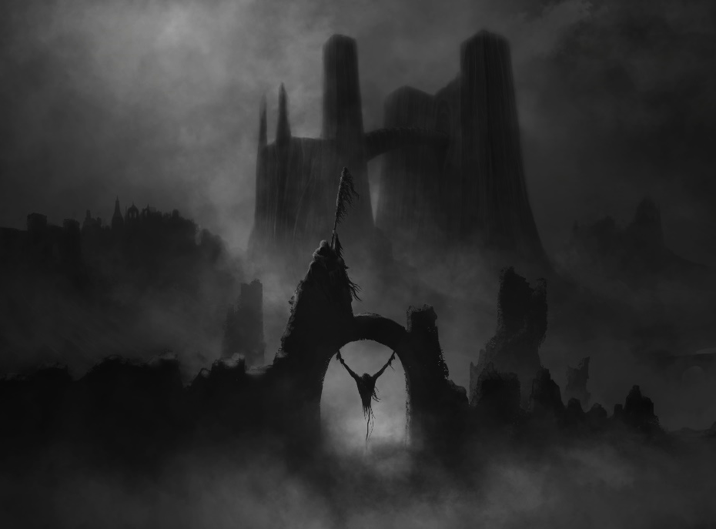
Enlil separated heaven from earth and claimed the earth as his domain. Humans were believed to have been created by Enki, the son of An and Nammu.
Heaven was reserved exclusively for gods and, upon their deaths, all mortals' spirits, regardless of their behavior while alive, were believed to go to Kur, a cold, dark cavern deep beneath the earth.
Kur or Irkalla

Slide 12
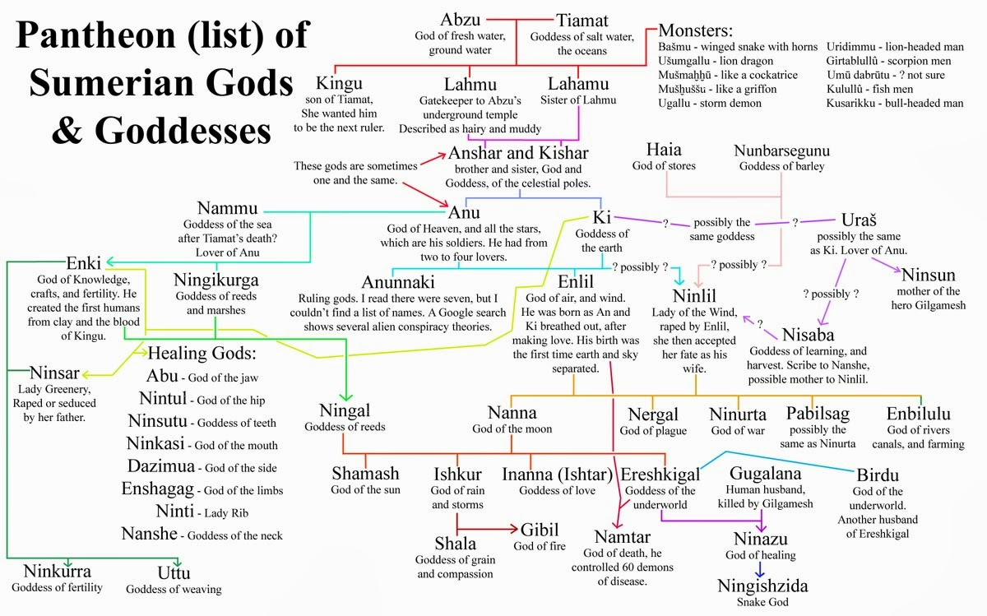

Slide 13
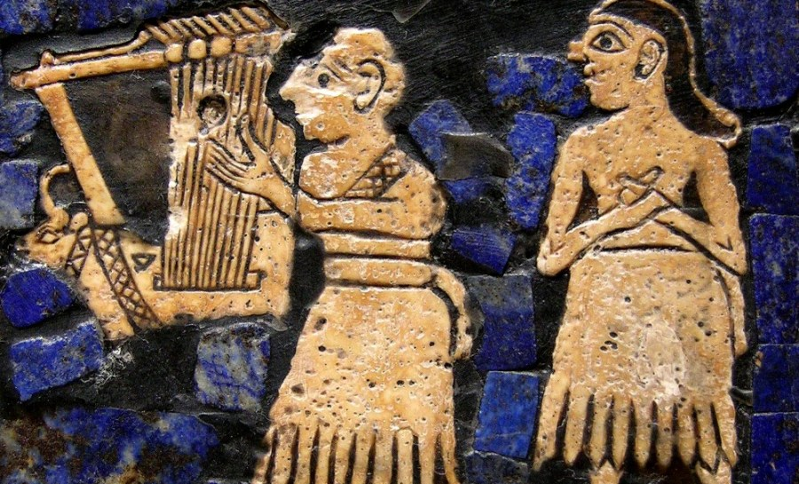
Sumerians believed that to succeed in life, you had to please the gods. So, they had to be served. Priests, people that led the religious life of the society, had great status in Sumer since people relied on them to gain the gods’ favor.

Slide 14
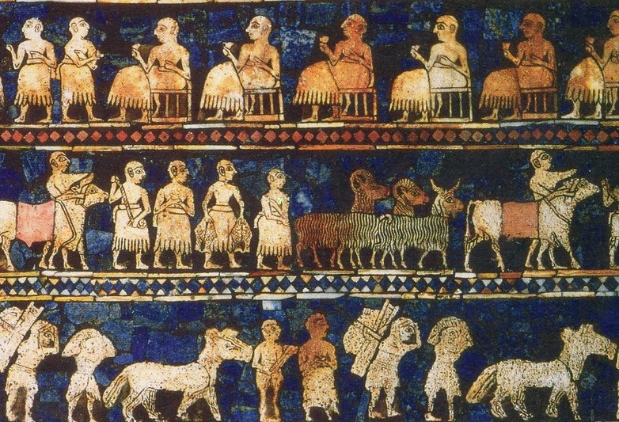
Sumerian Social Order
Because of their status, priests occupied a high level in Sumer’s social hierarchy, or the division of society by rank or class. For a time, priests outranked kings. Below them were the crafters, merchants, and the traders. Below these were the farmers, the laborers and the slaves.

Slide 15
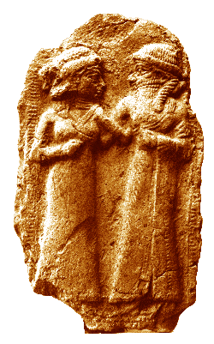
Men & Women in Sumer
Marriage in Mesopotamia was very important to the society, since it ensured the continuation of the family line and provided social stability. Arranged marriages were normal. The couple had often never met, and there were even bridal auctions, where women were sold to the highest bidder, but human relationships in Mesopotamia were just as complex and layered as those today and part of that complexity was due to real love.

Slide 16
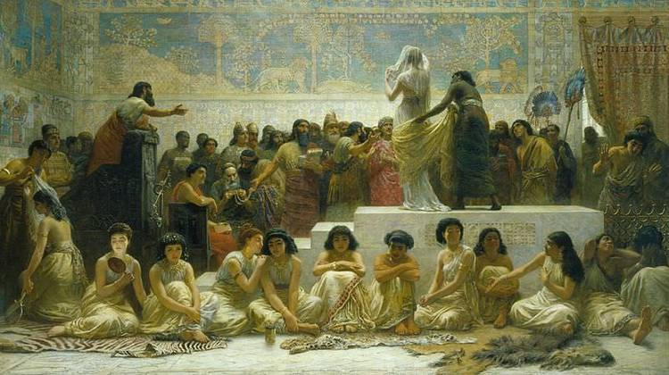
So while love had its part in Mesopotamian marriages, according to the customs of Mesopotamian society, marriage was a legal contract between the father of a girl and another man (the groom, as in the case of the bride auction where the groom paid the girl's father the bride-price) or between two families, which functioned as the foundation of a community.

Slide 17
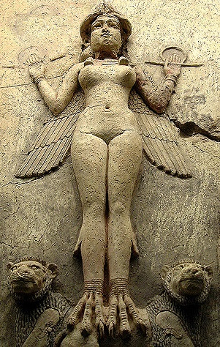
Men usually held political power, while women managed the household and the children. Men were educated as were most upper class women. Many of these women became priestesses in the temples.
The first known female composition is a hymn by Princess Enheduanna, to worship the goddess Inanna (later, Ishtar).

Slide 18
Final thoughts
Sumerians created the first political unit: the city-state.
The Akkadians, under the rule of Sargon, eventually became the oldest empire we know about.
Sumerians were polytheists because the worshipped many gods.
Sumerians created a society with clear divisions of rank or class.

Slide 19
NEXT
ACHIEVEMENTS
Jim Soto © 2018

