Slide 1
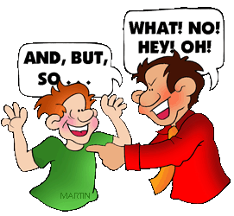
Listening & Speaking
Jim Soto

Slide 2
Lesson Objective
Develop listening skills
Learn how to be an effective group member
Improve speaking skills
Pages 417-422

Slide 3
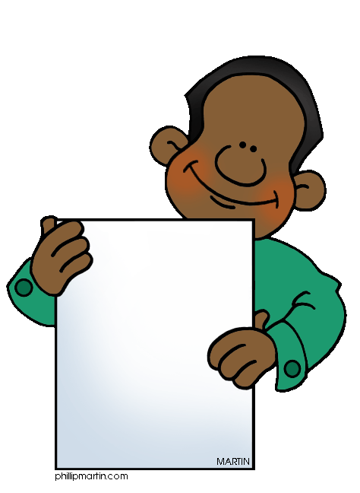
Listening in Class
Listening and speaking are things we do all the time without realizing how important they are. You can’t get useful information if you don’t listen. Others won’t understand you if your ideas aren’t expressed clearly. Check out this question.
Is there a difference between hearing and listening?

Slide 4
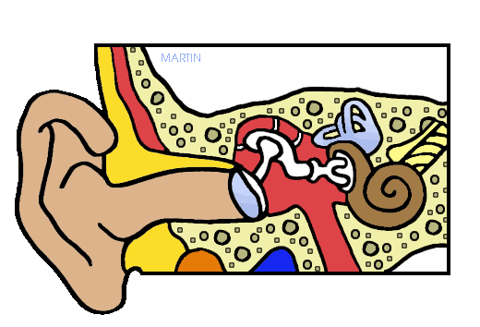
Listening in Class
Listening takes more effort than hearing. To listen you need to pay attention, stay focused(!), and think about what is being said. Believe it or not, it’s harder to be a good listener than to be a good speaker.
Now read pages 418-419 and complete all the seatwork at the bottom of each page.

Slide 5
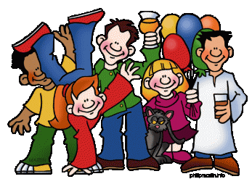
Participating in a Group
When you work with others you need to:
Listen to what others are saying
Add to their thoughts
Ask them to react to your ideas
This will make working in a group smooth.

Slide 6
Participating in a Group
Now get together with your team mates, have a group reading of pages 420-421 and complete all the Try IT activities at the bottom of each page. Turn it in when completed.

Slide 7
Speaking in Class
To master the skill of speaking consider the following before you speak:
Listen to what others are saying and take notes
Think about what others said
Wait for your turn to speak
Add something positive to the discussion

Slide 8
Speaking in Class
To master the skill of speaking consider the following when you speak:
Speak loud and clear enough
Stick to the topic
Avoid repeating what has already been said
Support your ideas with examples
Look at others in the group

Slide 9
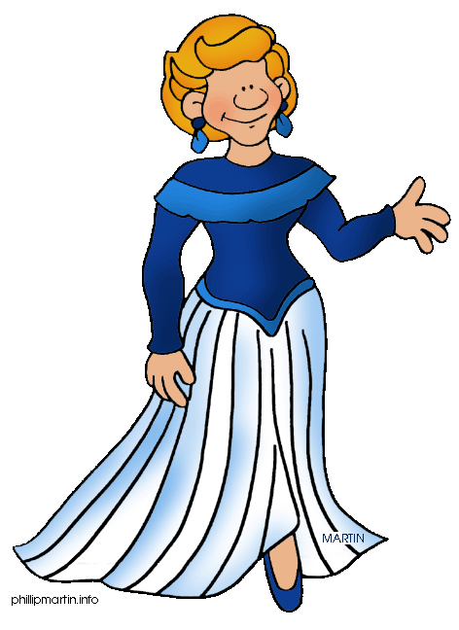
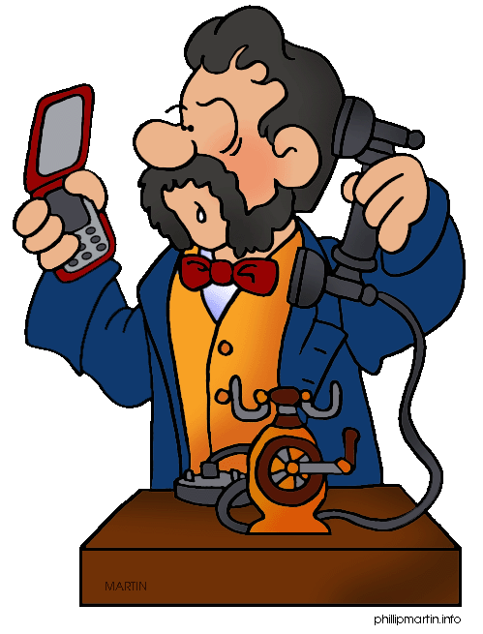
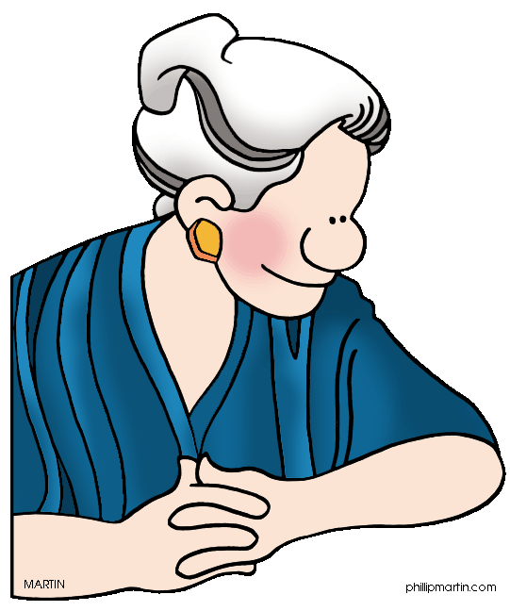
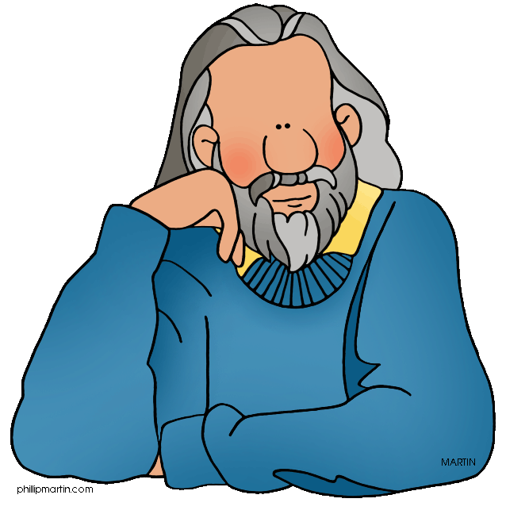
“Twenty-Question Who Am I?”
Lets play a game. Read the instructions on page 422 to play “Twenty-Question Who Am I?” Enjoy!

Slide 10
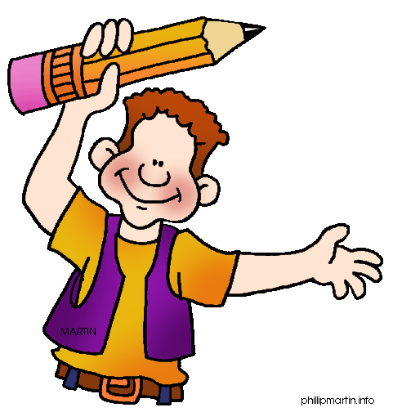
Homework
In your Skills Book complete pgs. 49-54.
Captalization 1
Captalization 2
Abbreviations and Numbers
Aha!

Slide 11
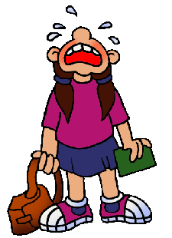
Next
Descriptive Essay
Jim Soto © 2015

