Slide 1
Why Writing?
Jim Soto

Slide 2
Why write?
Take a minute and read the story in page 1.
Reflect on your experience as a writer. What has been good? What has been bad?

Slide 3
Why take this course?
Short answer: Your writing sucks.
Long answer: Your writing still sucks.
Longer answer: You need to take this course in order to succeed in life.

Slide 4
Adults communicate in writing on a daily basis through notes, work activity logs and forms, e-mails, online service forms, shopping lists, research papers, essays and so on.
Learning how to write effectively is one
of the most important life-long skills
you can acquire.

Slide 5
Grammar rules!
If our communication isn’t clear to others, we will have failed in our attempt to share our thoughts, concerns, and our knowledge.
An integral part of effective communication involves the correct usage of grammar. The rules of grammar were taught to you from Kinder to the sixth grade. Truth is: it doesn’t show.

Slide 6
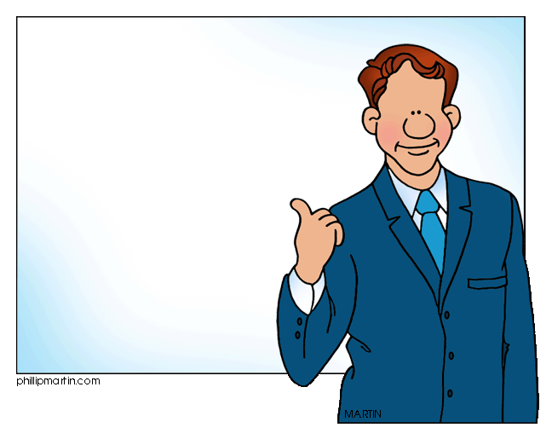
Reports indicate that the writing demands of most jobs—even at the entry level—are growing. Most business professionals need excellent writing skills to properly convey ideas and concepts.
Job security might very well
be linked to these skills…
even in this digital age of abbreviated texting and
tweets.

Slide 7
Test how much you suck!
The following passage has twenty errors. You’ll have twenty minutes to rewrite it correctly in your notebook:

Slide 8
Cell Phones Endanger Drivers
One of the recent developments in modern technology, cellular phones, can be a threat to safety. A study for Donald Redmond and Robert Lim of the university of Toronto showed that cellular phones poses a risk to drivers. In fact people who talk by the phone while driving are for times more likely to have an automobile accident than those whom do not use the phone while drive. I like to use my cell phone when I am driving because it is convenient. The researchers studied 699 drivers. Who were in an automobile accident while they were using they're cellular phones. The researchers concluded that the mane reason for the accidents was not that people used one hand for the telephone and one hand for driving. Instead the cause of accidents were usually that the drivers became distracted angry or upset by the phone call. As a result the drivers' lost concentration. Many people find that monthly plans are more economical than pre-paid plans.

Slide 9
Cell Phones Endanger Drivers Dangerous Drivers on Cell Phones (suggested title) (No underline in titles; no full sentence as “endanger” is a verb) Errors 1, 2
(indent missing 3) One of the recent developments in (of-preposition 4) modern technology, cellular phones, can be a threat to safety. A study for Donald Redmond and Robert Lim of the (capital “U” 5) University of Toronto showed (study is in the past; completed could be present tense) that cellular phones pose (subject-verb “phones pose” 6) a risk to drivers. In fact, (comma missing after “In fact” or “in addition” and so on 7) people who talk on (“by” to “on” 8) the phone while driving are four (spelling mistake on “four” 9) times more likely to have an automobile accident than those who (“Who” not “whom” 10) do not use the phone while driving (“drive” changed to “driving” 11). I like to use my cell phone when I am driving because it is convenient. (Off topic sentence; should be omitted 12) The researchers studied 699 drivers who were in an automobile accident while they were using their (“they’re” changed to possessive “their” 13) cellular phones. (sentence fragment should be joined to previous sentence. 14) The researchers concluded that the main (“mane” should be spelled “main” 15) reason for the accidents was not that people used one hand for the telephone and one hand for driving. Instead, (introductory word “Instead” takes a comma 16) the cause of accidents were usually that the drivers became distracted, (comma for a list after “distracted” 17) angry or upset by the phone call. As a result, (comma again after “as a result” 18) the drivers (no apostrophe as no possessive 19) lost concentration. Many people find that monthly plans are more economical than pre-paid plans. (not a concluding sentence 20)

Slide 10
How did you score?
0 – 19 : Your writing sucks!
20 : You lie and your writing sucks!
Bottom line: YOU NEED THIS COURSE!

Slide 11
More Reasons to Write
You write:
To share your experiences
To learn
To show your understanding
To share ideas

Slide 12
Skills Assessments
Complete:
In today’s Grammar and Writing Skills complete the Using the Right Word Test Prep on pgs. 688-689.

Slide 13
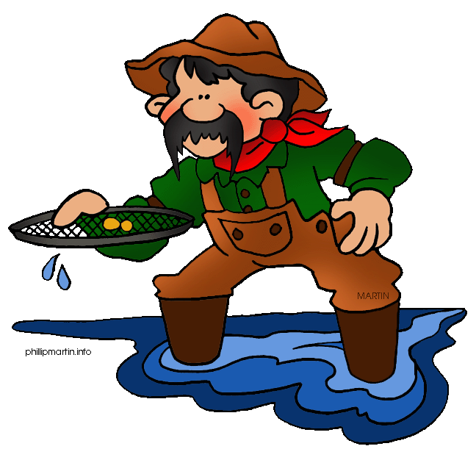
Next
Understanding the Writing Process
Jim Soto © 2015

