Slide 1
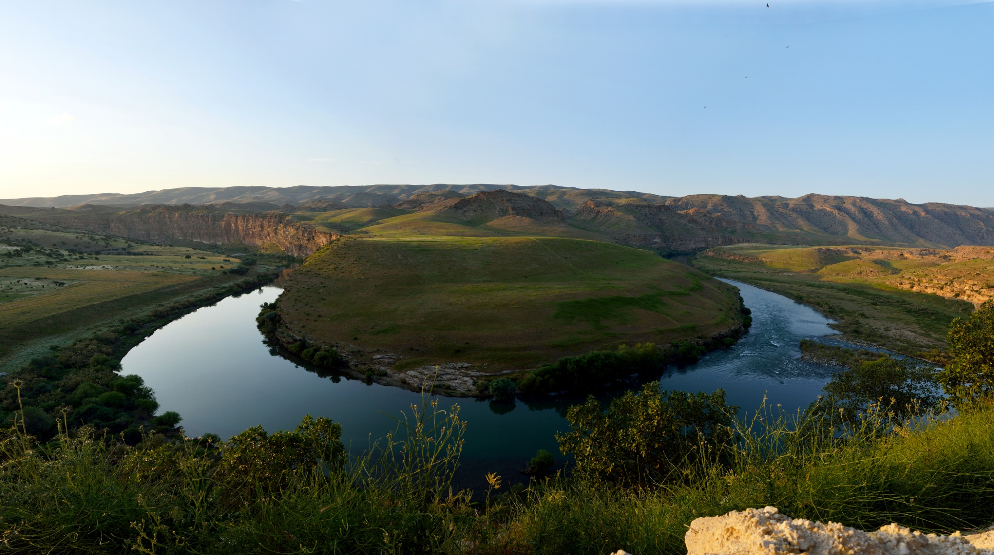
WORLD HISTORY
Geography of the Fertile Crescent
with Mr. Jim Soto

Slide 2
Think...
The year is 4,000 B.C.
You are a farmer in Southwest Asia. You live near a slow-moving river, with many shallow lakes and marshes. The abundance of water make the land rich and fertile, so you can grow wheat and dates. During the hot summers, you are often short on water and fear your crops will die. How can you control the water of the river?
Take a minute to write it down.

Slide 3
The valleys of the Tigris and Euphrates rivers were the site of what we believe to be the world’s first great civilizations.

Slide 4
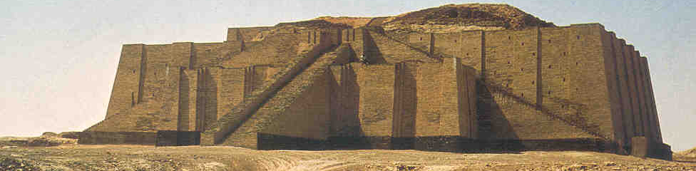
To learn more about this topic read pages 56 thru 61 and complete the section 1 assessment. Show me the completed work when complete.

Slide 5
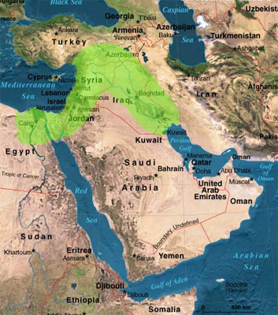
The Land Between Rivers
Early people settled where particular crops grew. They grew well near rivers and where the ground was fertile. The first 4 mayor civilizations were established in river valleys. Let’s watch a video on the subject.
Click Here!

Slide 6
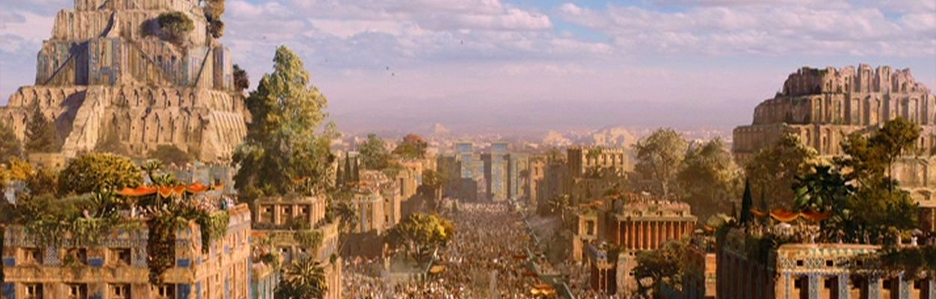
One particular area, known today as the Fertile Crescent was particularly well suited for farming. Mesopotamia, or the “land between two rivers” was located in this area between the Tigris and Euphrates rivers.

Slide 7
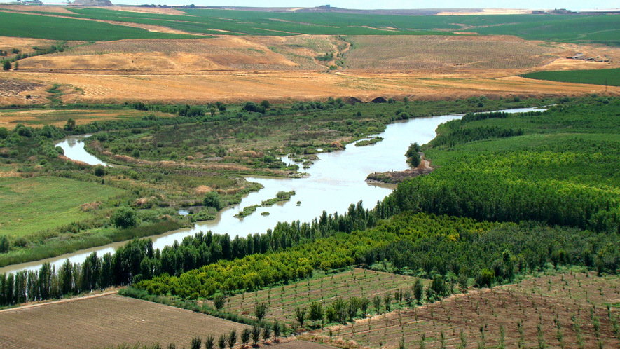
The Rise of Civilization
Although, there were inhabitants in the region over 12,000 years ago, it wasn’t until 7,000 years ago that civilization took off with the development of farming. What made the land here so fertile?
The abundant water and silt from the area made it very fertile.

Slide 8
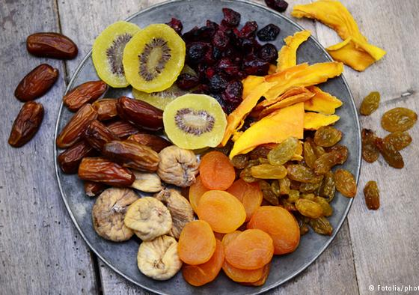
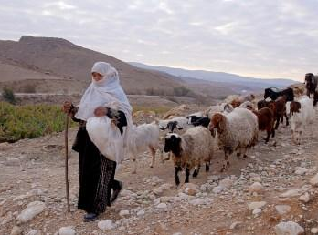
Typical crops included:
Wheat
Barley
Figs
Onions
Apples
Grapes, among many others.
Fish and livestock, such as:
Sheep
Goat
Cattle, were also abundant.

Slide 9
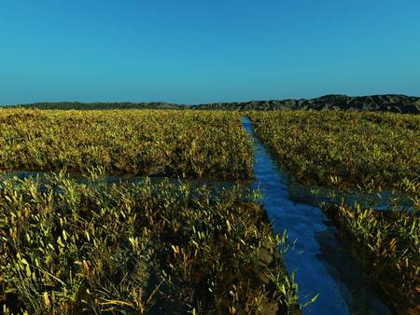
Controlling Water
Cities could not conceivably exist without the ability to control the water sources in the area. Water supplies rely on rainfall. Too much rain and you have floods. Too little rain and you have a drought. Water has to be managed in a way that avoids these situations. Irrigation helps solve this. Let’s watch a video on the subject.
Click Here!

Slide 10
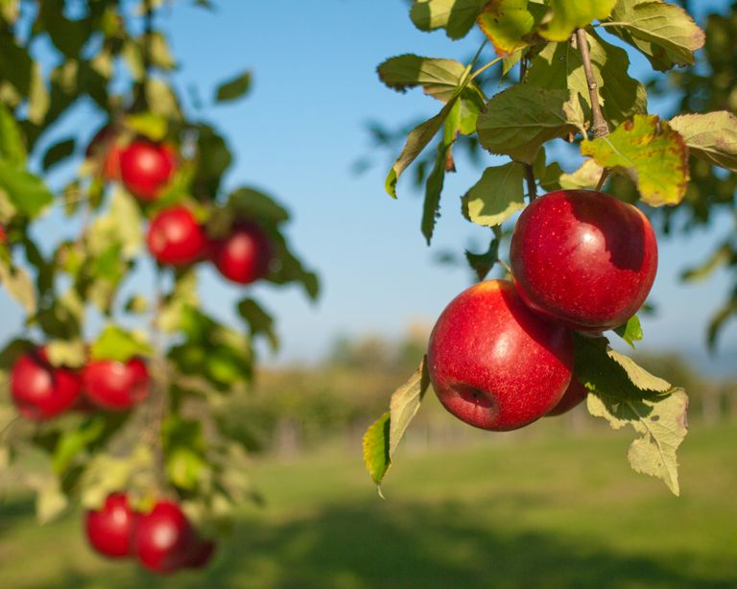
Food Surpluses
Because farming techniques improved and became more and more sucessesful, there were food surpluses, or more food than was really needed.
Because less people were needed to farm, they occupied themselves with other jobs, such as: crafters, religious leaders, or government officials. This was the birth of what we call division of labor.

Slide 11
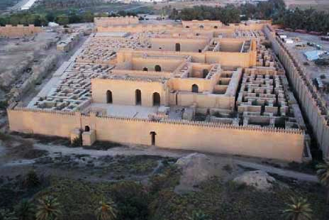
Over time, the Mesopotamian settlements grew in size and complexity. By 4,000 BC it became the powerful center of political, economic, religious and cultural civilization we have come to know.

Slide 12
Final thoughts
Mesopotamia’s fertile lands supported productive farming.
Farming is instrumental in the development of any city.
Farming became so sophisticated, that less people were needed to engage it. This opened the door other specialized occupations to develop.

Slide 13
NEXT
SUMER
RISES
Jim Soto © 2018

